Slide 1
Round robin Intercomparison Preliminary results

Slide 2
Round robin intercomparison
Fill ID | Cylinder ID | Filling Detail | Pressure | CH4 [ppb] | CO2 [ppm] | N2O [ppb] | CO [ppb] | H2O [ppm]
E-097A | DO45177 | Rix-Dubendorf, 130507 | 140 bar | 2074.9 | 455.7 | 330.93 | 574.9 | 241.7
E-110 | DO45170 (former H-226) | Rix-Rigi‡ | 140 bar | 1944.6 | 403.6 | 327.31 | 161.5 | 240.5
E-111 | DO45171 (former H-227) | 7.2 bar SA†, then Rix-Rigi‡ | 140 bar | 1854.4 | 384.9 | 312.06 | 158.6 | 148.9
E-112 | DO45180 (former H-228) | 30 bar Rix-Duebendorf (20th Frebruary 2014)* then fill at Rix-Rigi‡ | 140 bar | 1953.9 | 404.94 | 327.37 | 168.2 | 181.7
Notes:
Suggested cylinder to use

Slide 3
List of Compounds
HFC's | CFC's | HCFC's | Halons | Halocarbons
HFC-23 | CFC-11 | HCFC-141b | H-1301 | CH3Cl | CF4
HFC-32 | CFC-12 | HCFC-142b | H-1211 | CH3Br | SF6
HFC-134a | CFC-13 | HCFC-124 | H-2402 | CH3I | SO2F2
HFC-125 | CFC-113 |  |  | CH2Cl2
HFC-143a | CFC-114 |  |  | CHCl3
HFC-365mfc | CFC-115 |  |  | CHBr3
 |  |  |  | CCl4
 |  |  |  | TCE
 |  |  |  | PCE
Notes:
Suggested cylinder to use

Slide 4
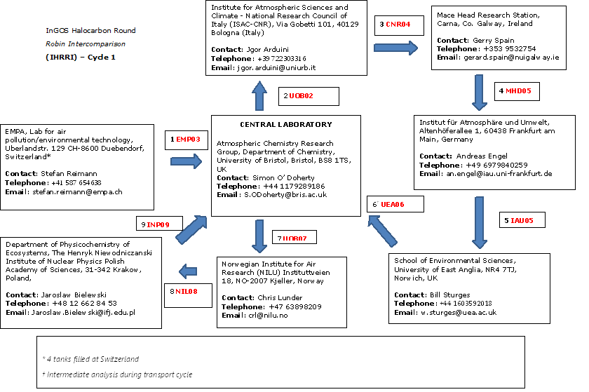
Notes:
Tert tanks filled at SIO are distributed to each AGAGE site

Slide 5
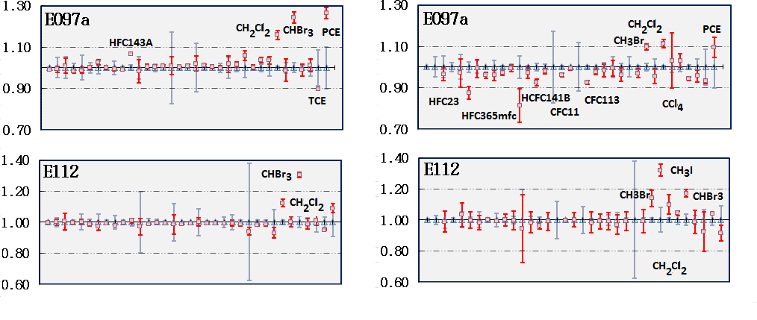

Slide 6
