Slide 1
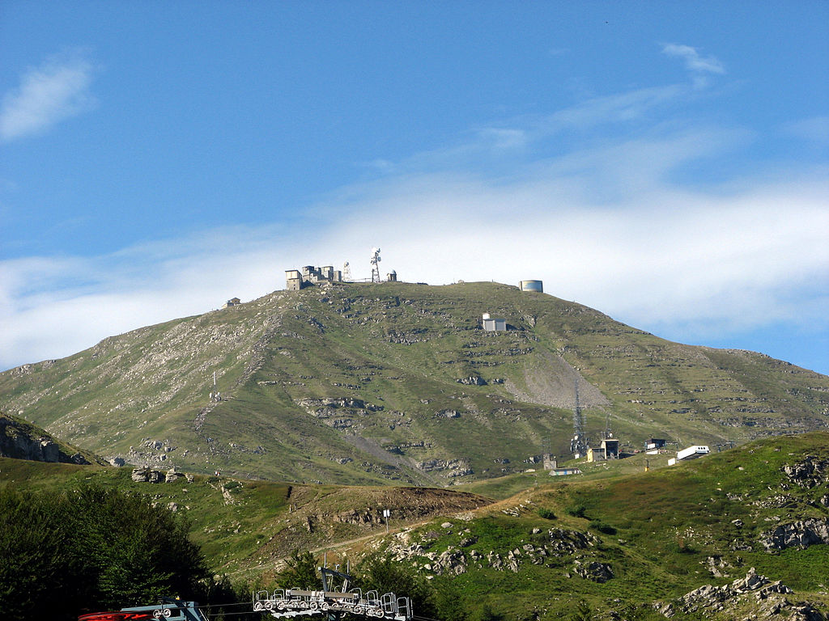
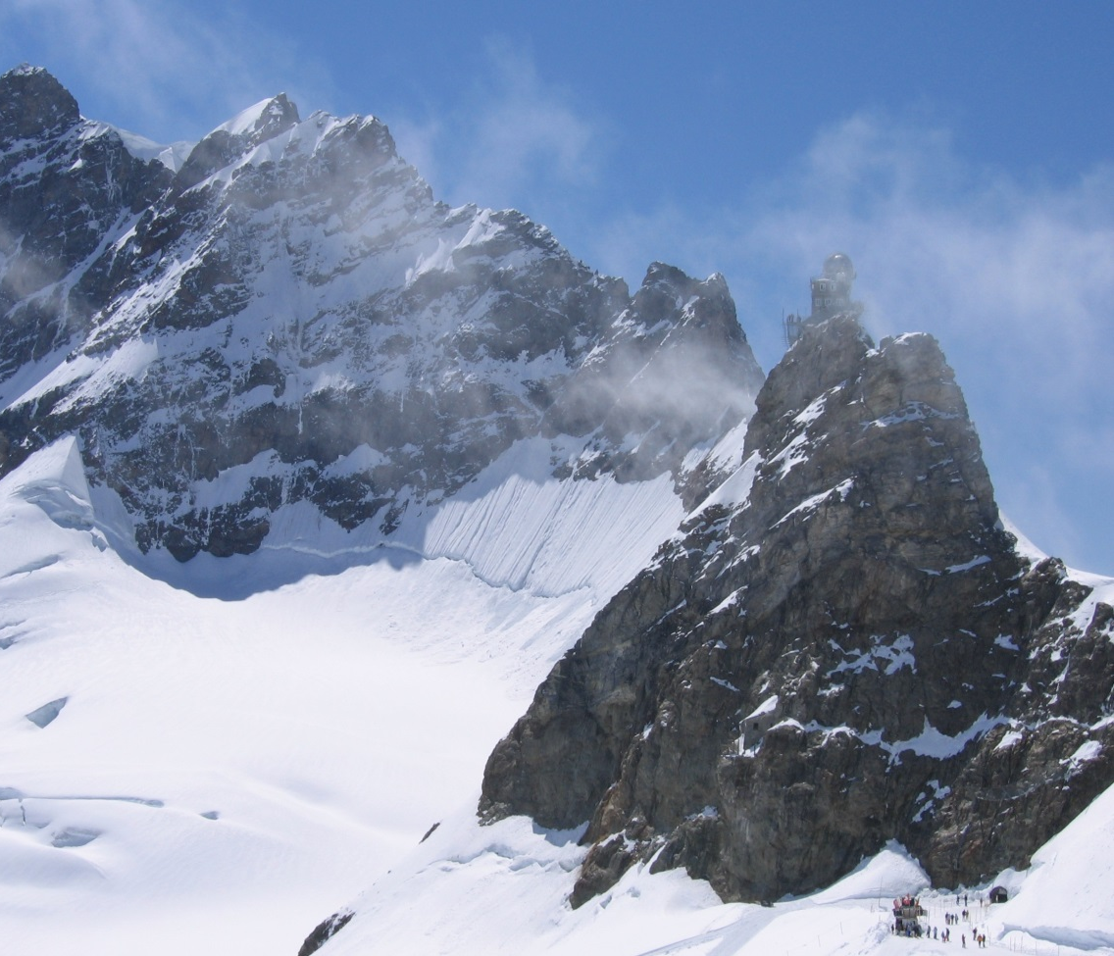
WP15.5: Inverse modeling of European halocarbon emissions D. Brunner, S. Henne, Empa, Switzerland A. Manning, UK MetOffice, United Kingdom R. Thompson, A. Stohl, NILU, Norway
INGOS Kickoff-Meeting, Harlem (NL), 21-21 Nov 2011

Slide 2
Plans for InGOS Task 15.5
Task 15.5: Modeling of halocarbons lead: Empa; contributors: NILU, MET
Inverse modeling of European halocarbon emissions based on different Lagrangian particle dispersion models
Deliverables:
D15.11: European halocarbon inversions using improved halocarbon measurements at InGOS stations (M42 = 1 Apr2015)
D15.14: Model intercomparison and analysis of European emissions of most important halocarbons with large GWPs (M45 = 1 Jul 2015)
Milestone “First European halocarbon inversions using measurements at InGOS stations”
(Oct 2013)

Slide 3
Modeling Protocol for 1st Set of Experiments
distributed in April 2013
Group Model Meteorology Method References
Empa1 FLEXPART ECMWF analyses Extended Brunner et al., 2012, 2013 0.2° x 0.2°, 3-hrly Kalman Filter
Empa2 FLEXPART ECMWF analyses Bayesian Stohl et al., 2009, 2010 0.2° x 0.2°, 3-hrly inversion Vollmer et al., 2009
NILU FLEXPART ECMWF analyses Bayesian Thompson et al., 2011, 2014 0.2° x 0.2°, 3-hrly inversion
UKMO NAME UKMO analyses Simulated Manning et al., 2011 25 x 25 km², 3-hrly annealing Rigby et al., 2011
4 Inversion experiments Measurements from AGAGE sites Mace Head, Jungfraujoch and Mt. Cimone
Observations extracted by Empa from AGAGE archive and re-distributed to all partners
ID Trace gas A priori inventory Time period
H11 HFC-125 EDGARv4.2 2008 2011
H12 HFC-134a EDGARv4.2 2008 2011
H13 HCFC-141b EDGARv4.2 2008 2011
H14 HFC-125 no a priori 2011

Slide 4
Modeling Protocol for 1st Set of Experiments
Model output – Station time series
observation value assimilated (e.g. 3-hour mean)
applied measurement uncertainty
applied model uncertainty
overall data uncertainty (model-data mismatch)
a priori mixing ratio
a posteriori mixing ratio
Model output - Emissions
Gridded annual emissions (kg cell⁻¹ yr⁻¹ or kg m⁻² yr⁻¹) for a domain covering at least the region 12°W-24°E, 36°N-58°N
Aggregated emissions for at least the following countries: Italy, Germany, BeNeLux, Ireland, United Kingdom, France, Spain+Portugal, Austria, Switzerland
Uncertainties of aggregated country emissions
Original deadline: 31 August 2013; All results received by December 2013; MS65

Slide 5
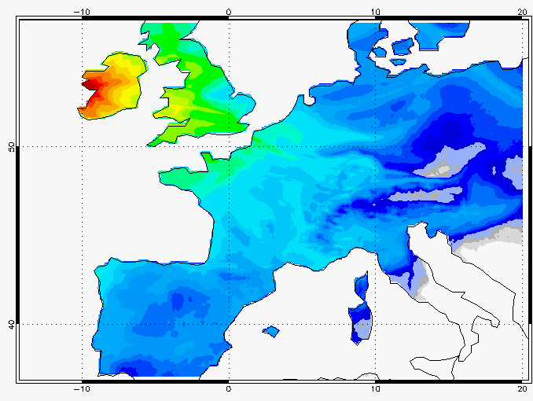
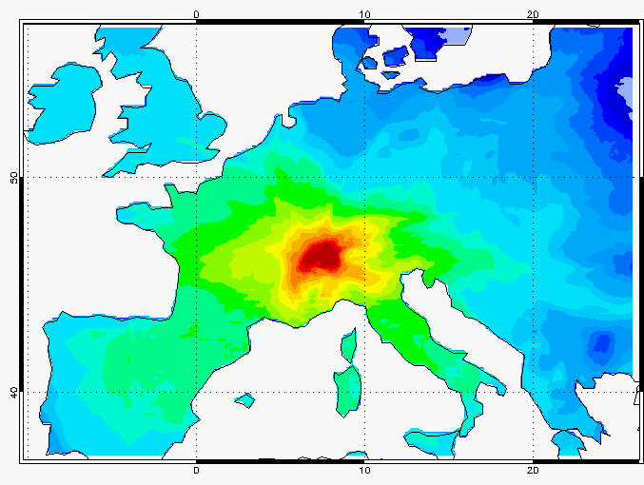
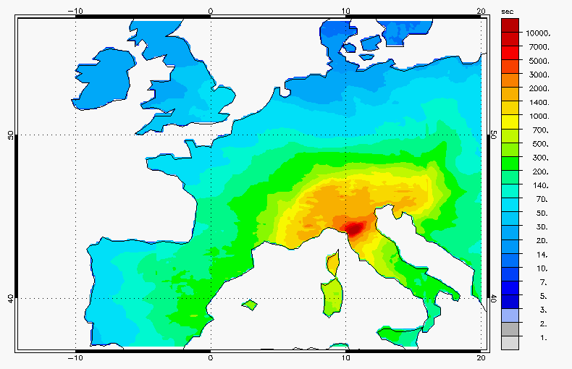
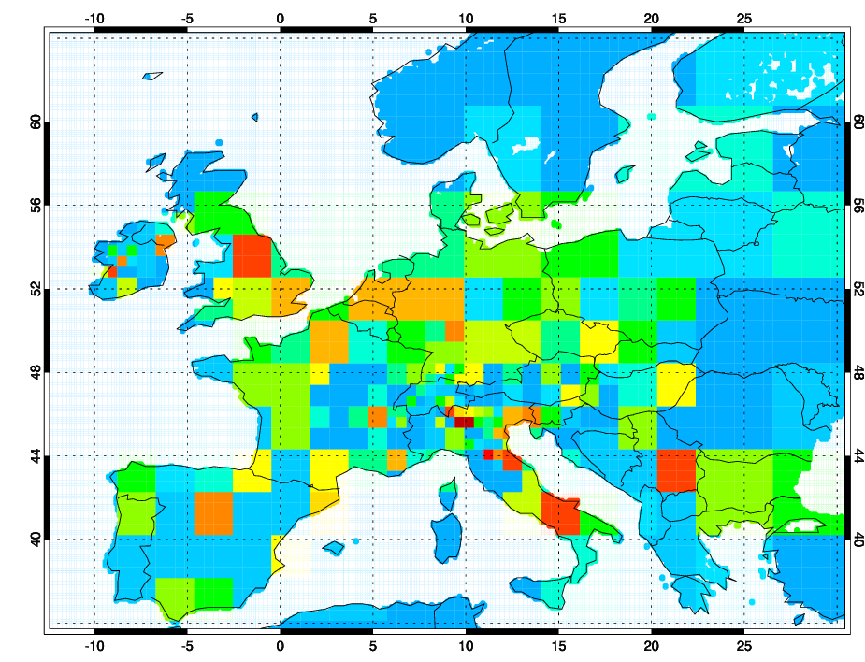
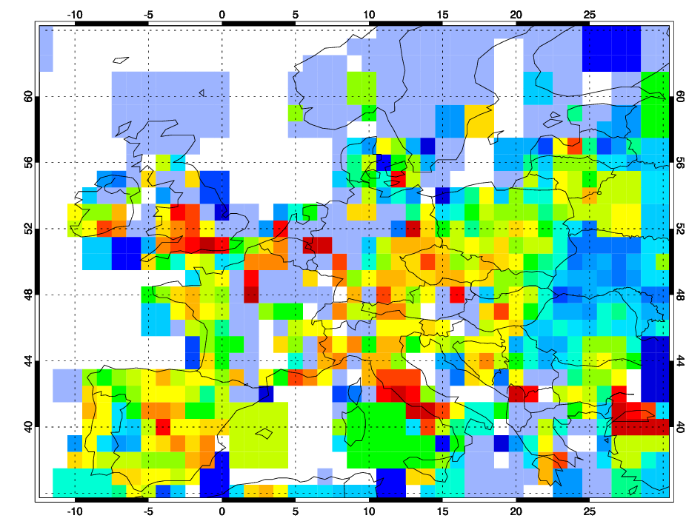
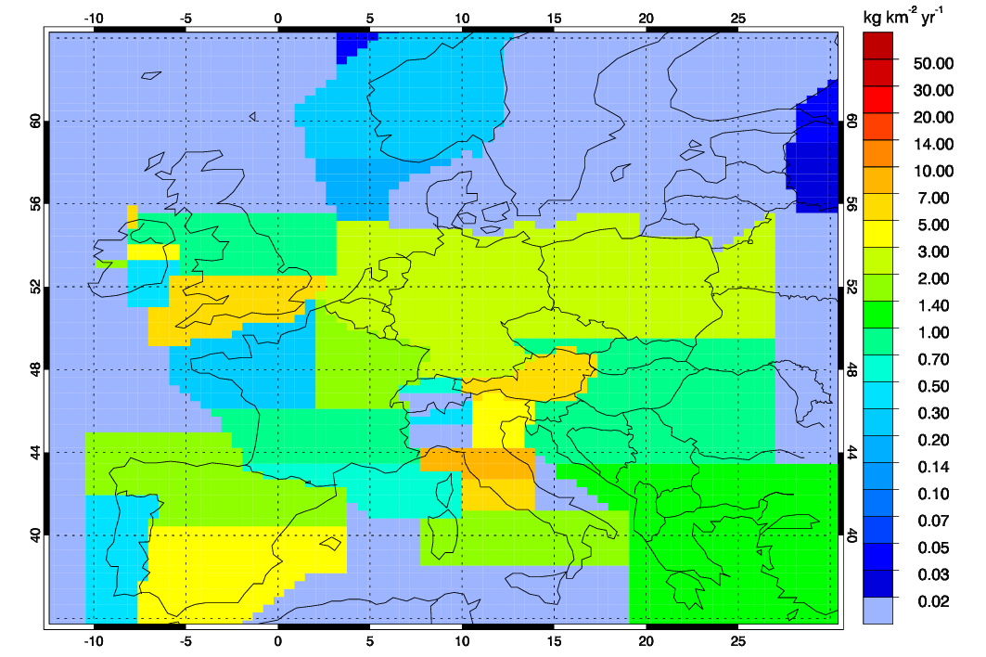
Mean Surface Sensitivity Maps (footprints) of the 3 Measurement Sites (2011)
Mace Head (10 m a.s.l.)
Jungfraujoch (3580 m a.s.l)
Monte Cimone (2165 m a.s.l)
Corresponding reduced grids for mathematical inversion
Empa-1
NILU
UKMO

Slide 6
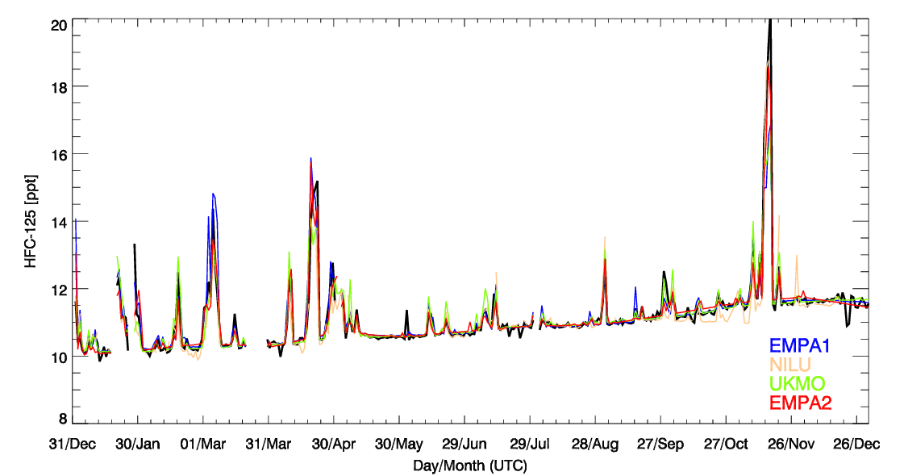
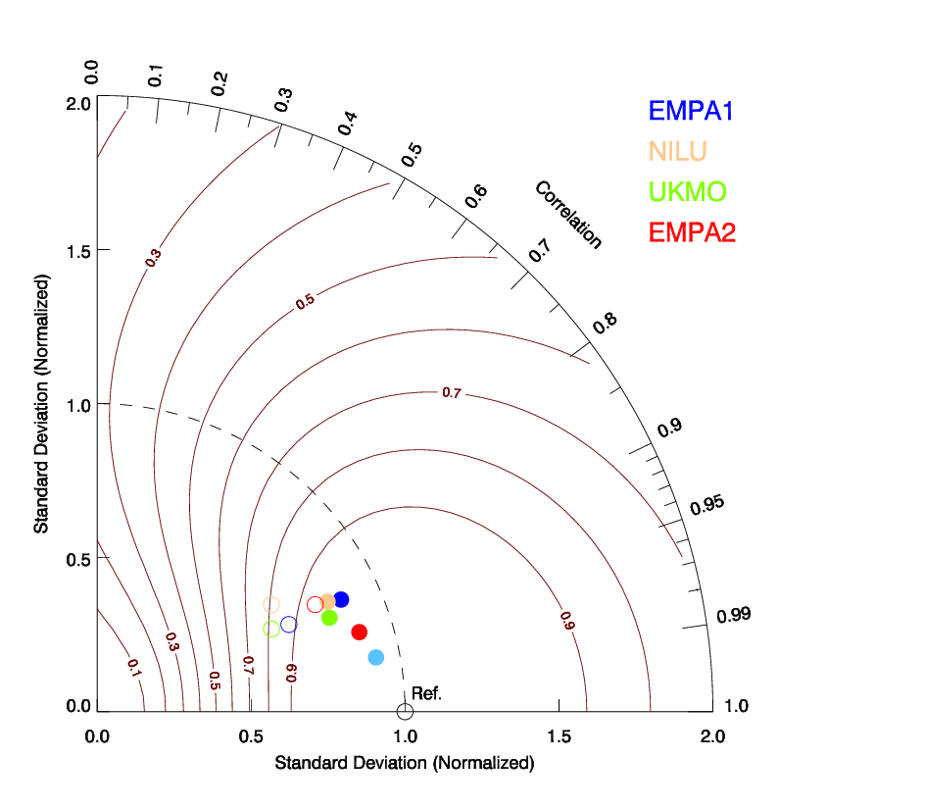
Posterior HFC-125 Time Series
Mace Head
meas
full KF
Notes:
Baseline remains low for NILU: Does this result in increased UK/Ireland emsission?

Slide 7
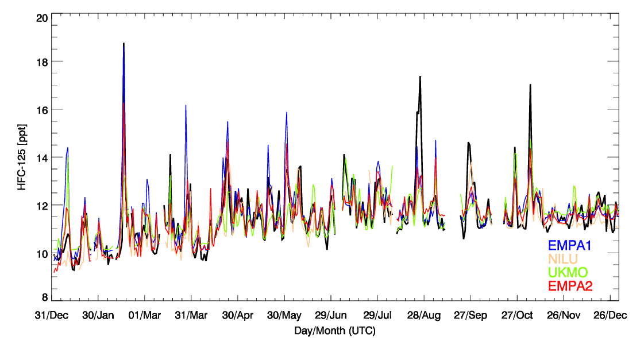
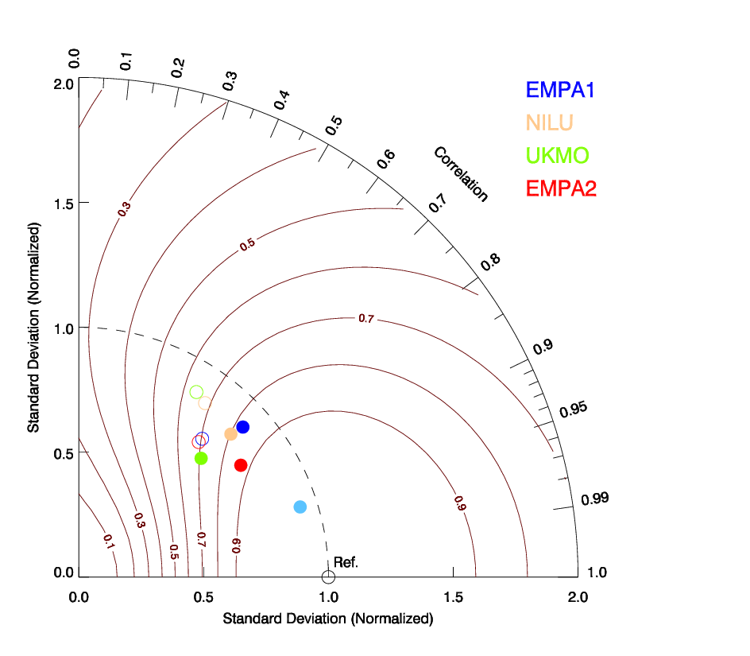
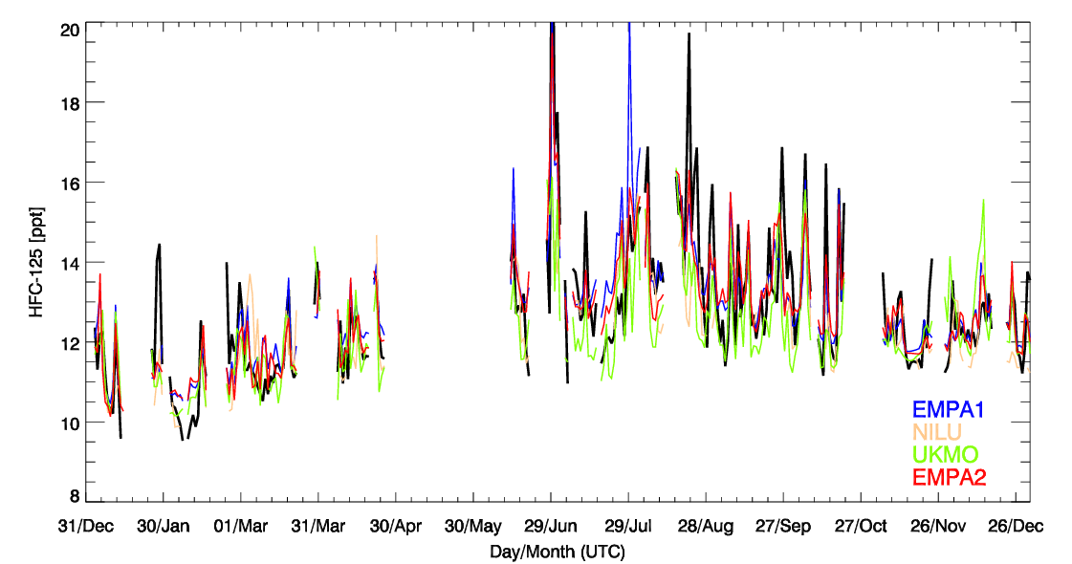
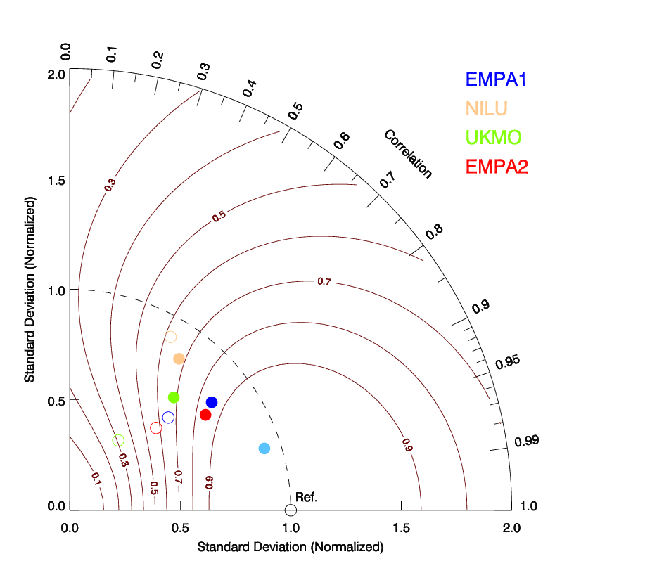
Posterior HFC-125 Time Series
Jungfraujoch
meas
Mt. Cimone

Slide 8
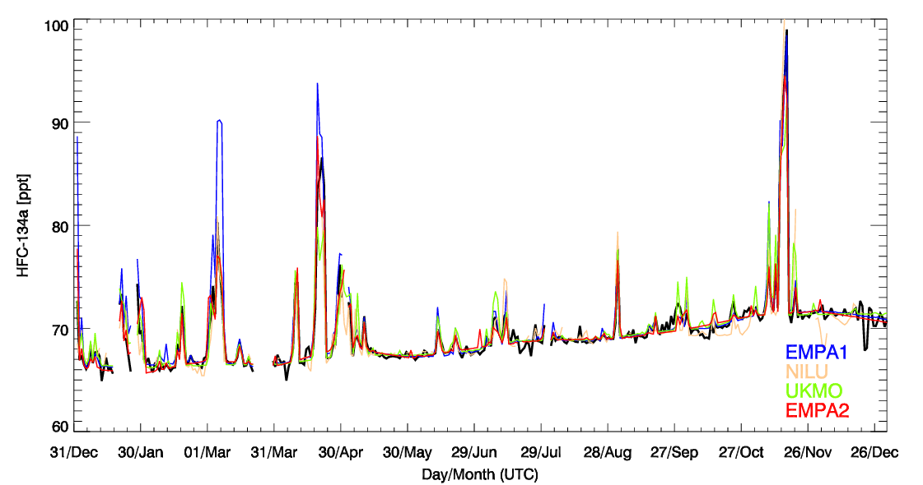
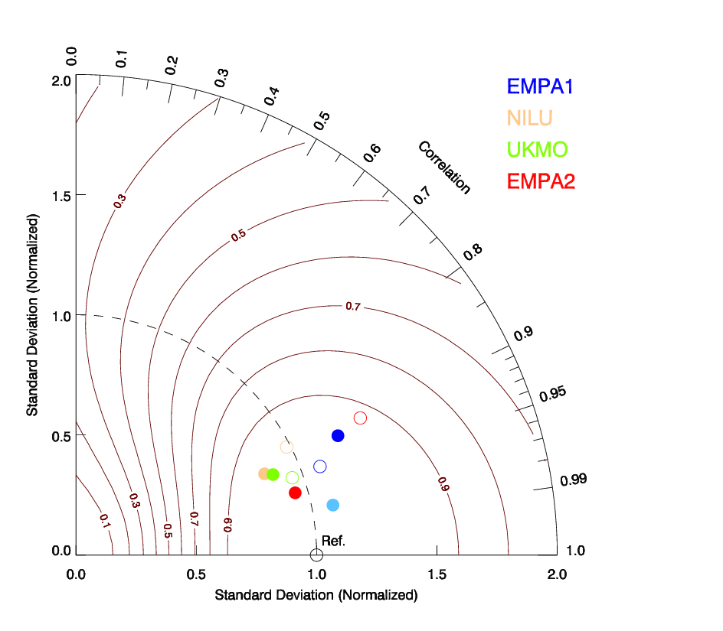
Posterior HFC-134a Time Series
Mace Head
meas

Slide 9
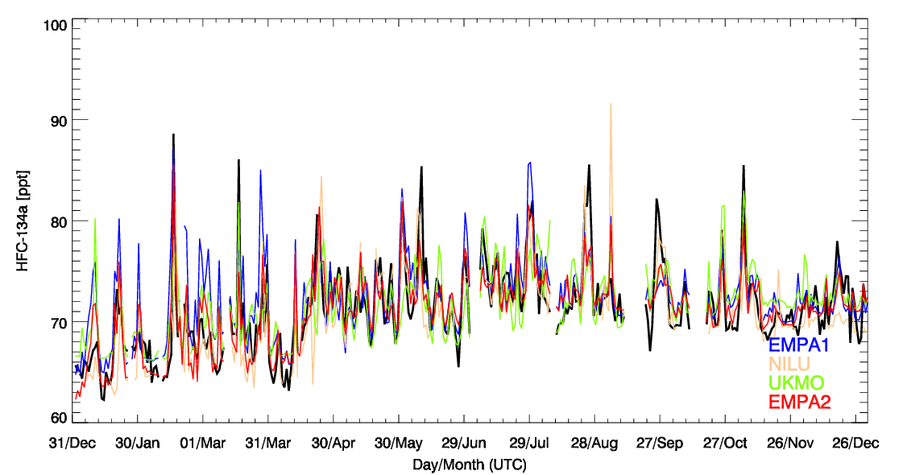
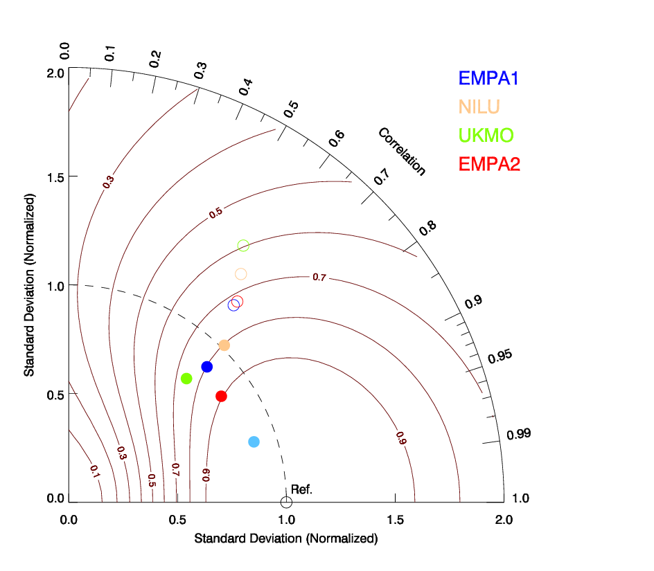
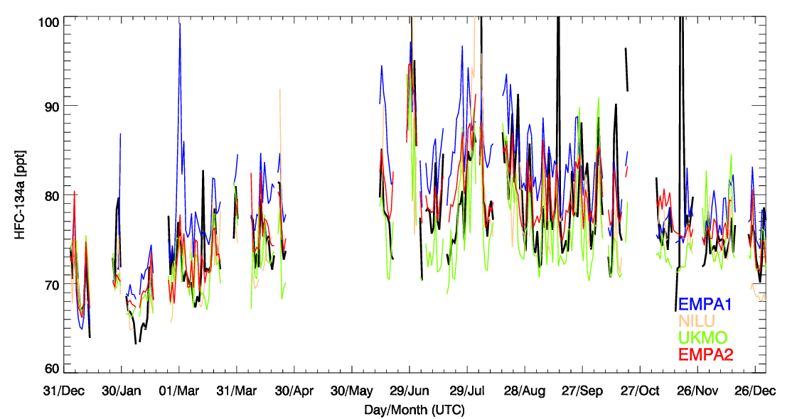
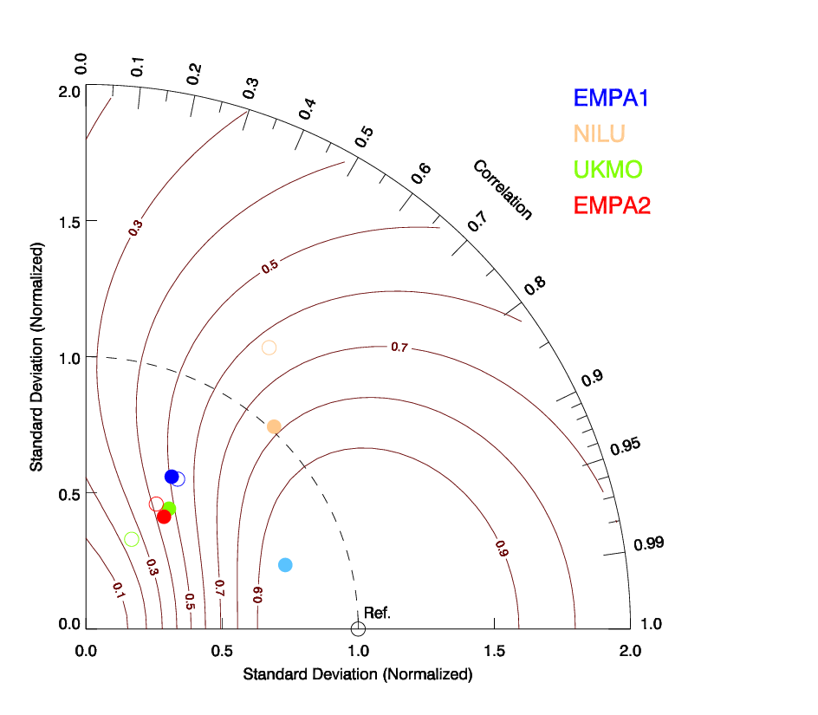
Posterior HFC-134a Time Series
Jungfraujoch
meas
Mt. Cimone

Slide 10
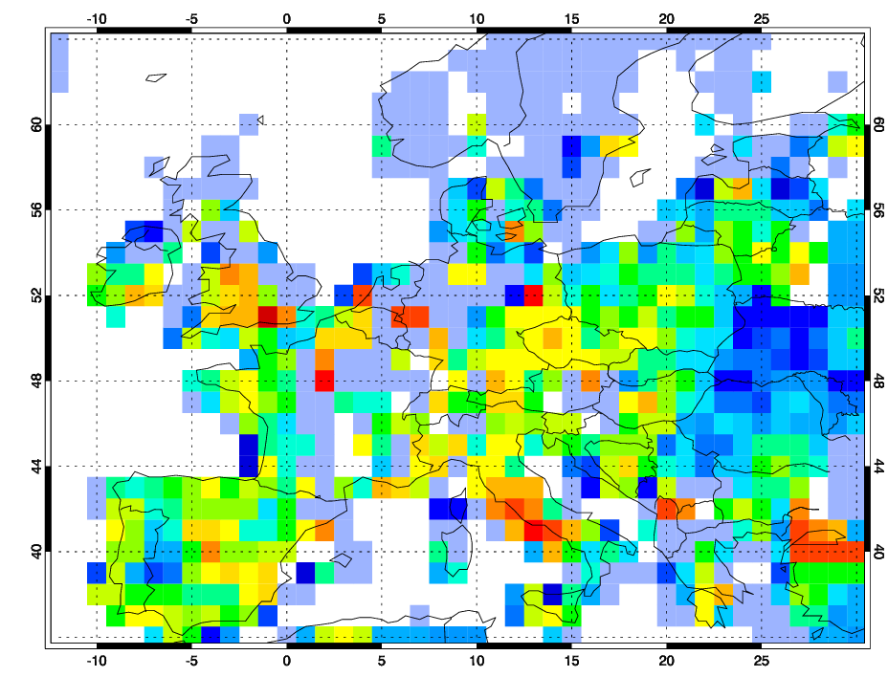
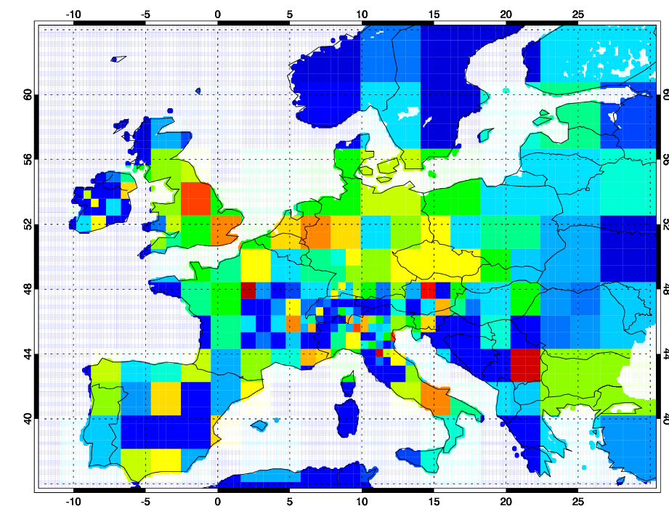
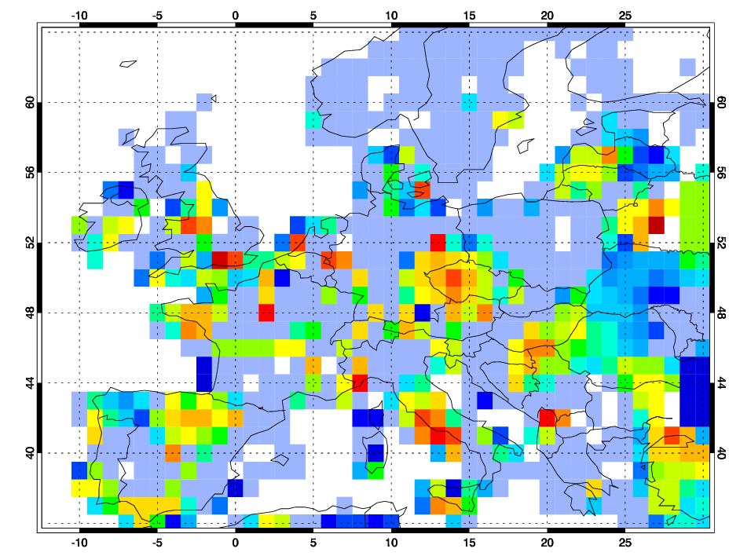
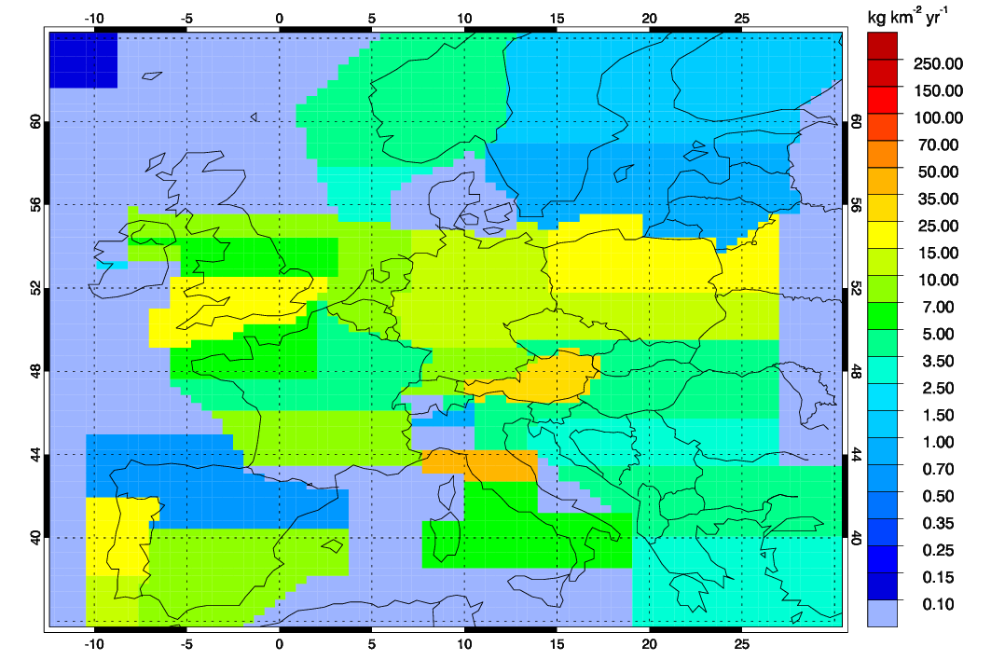
Comparison of Gridded Emissions
HFC-125
Empa
NILU
UKMO
HFC-134a
Empa
NILU
UKMO

Slide 11
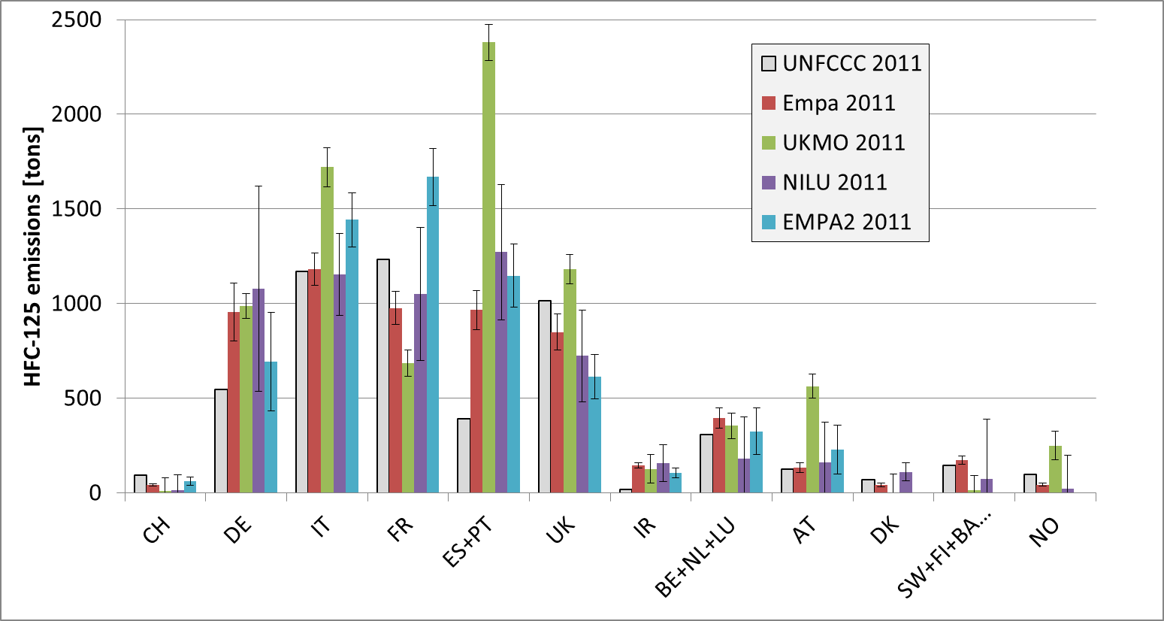
Comparison of National Total Emissions
HFC-125
Reasonable agreement with UNFCCC reported values for Italy, UK, Benelux
Higher than reported emissions for Germany, Spain+Portugal, Ireland
Large scatter for France, poor model results for Switzerland
Uncertainty estimates too optimistic for Empa1 and UKMO
Notes:
Italy: 2008: 891 tons

Slide 12
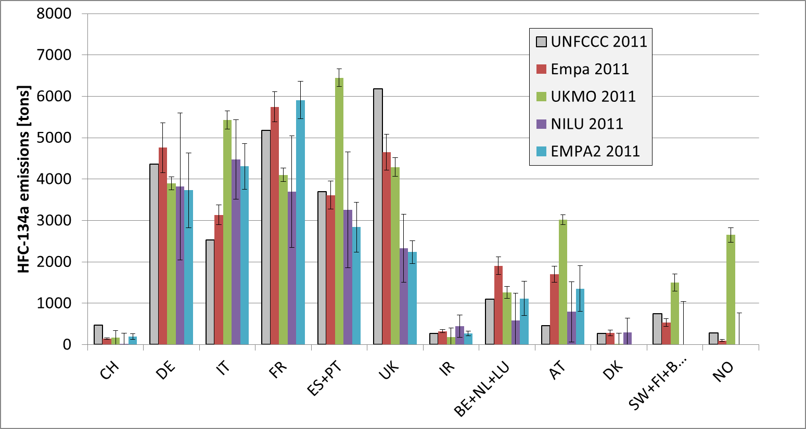
Comparison of National Total Emissions
HFC-134a
Reasonable agreement with UNFCCC reported values for Germany, France, Spain + Portugal, Ireland, Benelux
Higher than reported values for Italy, lower than reported for UK
Larger differences between models than for HFC-125

Slide 13
Conclusions From 1st Experiment
HCFC-141b inversion not feasible (not enough pollution peaks)
Despite large differences in grid resolution similar ability to reproduce observations (better at MHD than at JFJ, better at JFJ than CMN)
Model results in same range as bottom-up estimates
UNFCCC likely underestimates HFC-125 emissions from Ireland and Iberian countries
UNFCCC likely underestimates HFC-134a emissions from Italy and overestimates those from UK
Model results often deviate from each other more than uncertainty estimates would allow (Empa and UKMO uncertainties too small)
Results sensitive to design of covariance matrices & prior uncertainties
Second round needed: enhanced setup for better comparability (e.g. land-sea mask, resolution, uncertainties)

Slide 14
Modeling Protocol for 2nd Set of Experiments
distributed in Sept 2014
Group Model Meteorology Method References
Empa1 FLEXPART ECMWF analyses Extended Brunner et al., 2012, 2013 0.2° x 0.2°, 3-hrly Kalman Filter
Empa2 FLEXPART ECMWF analyses Bayesian Stohl et al., 2009, 2010 0.2° x 0.2°, 3-hrly inversion Vollmer et al., 2009
NILU FLEXPART ECMWF analyses Bayesian Thompson et al., 2011, 2014 0.2° x 0.2°, 3-hrly inversion
UKMO NAME UKMO analyses Simulated Manning et al., 2011 25 x 25 km², 3-hrly annealing Rigby et al., 2011
Additional reporting of:
Time series of a-priori and a-posteriori baseline mole factions
A-posteriori emissions and uncertainties on regular grid
4 Inversion experiments Measurements from AGAGE sites Mace Head, Jungfraujoch and Mt. Cimone
Updated observation uncertainty Updated a-priori uncertainties (Empa)
ID Trace gas A priori inventory Time period
H11v2 HFC-125 EDGARv4.2_FT2010 2011
H12v2 HFC-134a EDGARv4.2_FT2010 2011
H13v2 SF6 EDGARv4.2_FT2010 2011
H14v2 HFC-125 no/const a priori (100 % unc) 2011
EDGAR 4.2_FT2010
Contains only point sources in Western Europe?
Fall back to 4.2 2008

Slide 15
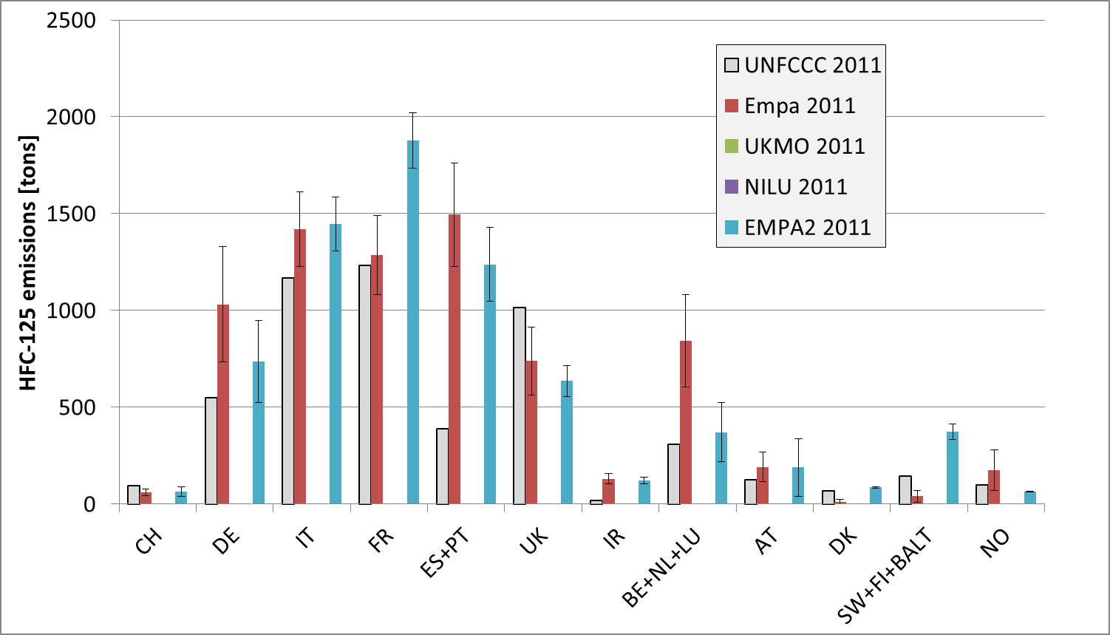
Comparison of National Total Emissions (2nd Set)
HFC-125
Reasonable agreement with UNFCCC reported values for Italy, UK, Benelux
Higher than reported emissions for Germany, Spain+Portugal, Ireland
Different emissions distribution France vs. Benelux

Slide 16
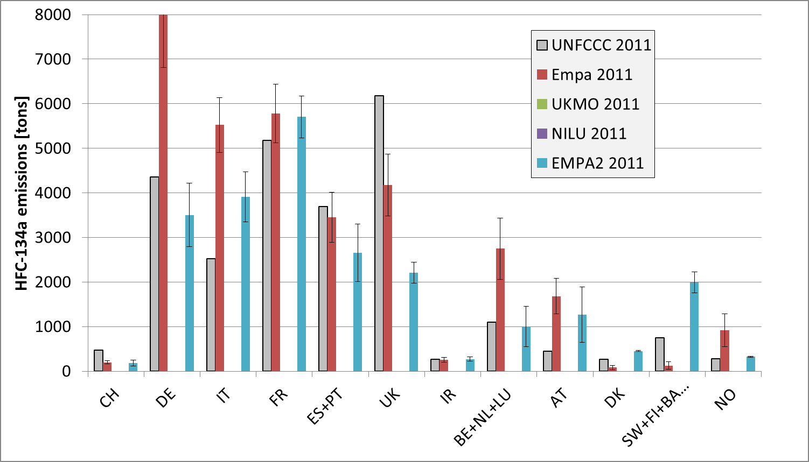
Comparison of National Total Emissions (2nd Set)
HFC-134a
Reasonable agreement with UNFCCC reported values for France, Spain + Portugal, Ireland, Benelux
Higher than reported values for Italy, lower than reported for UK
Large values for De and Benelux in Empa probably artefacts

Slide 17
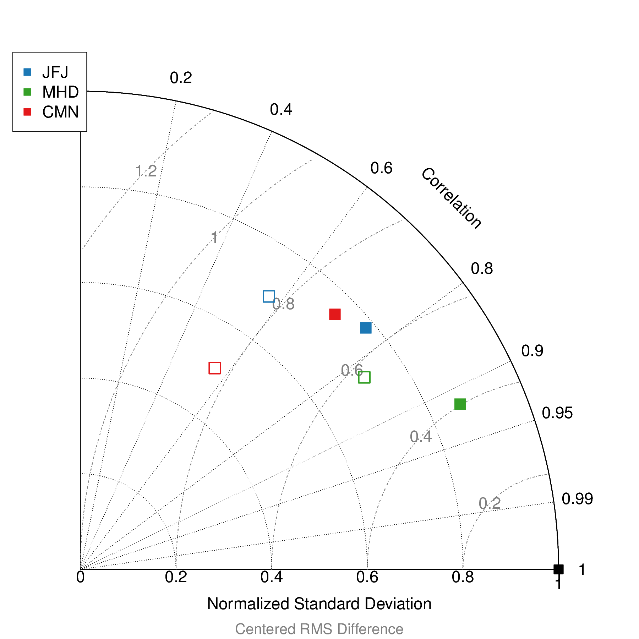
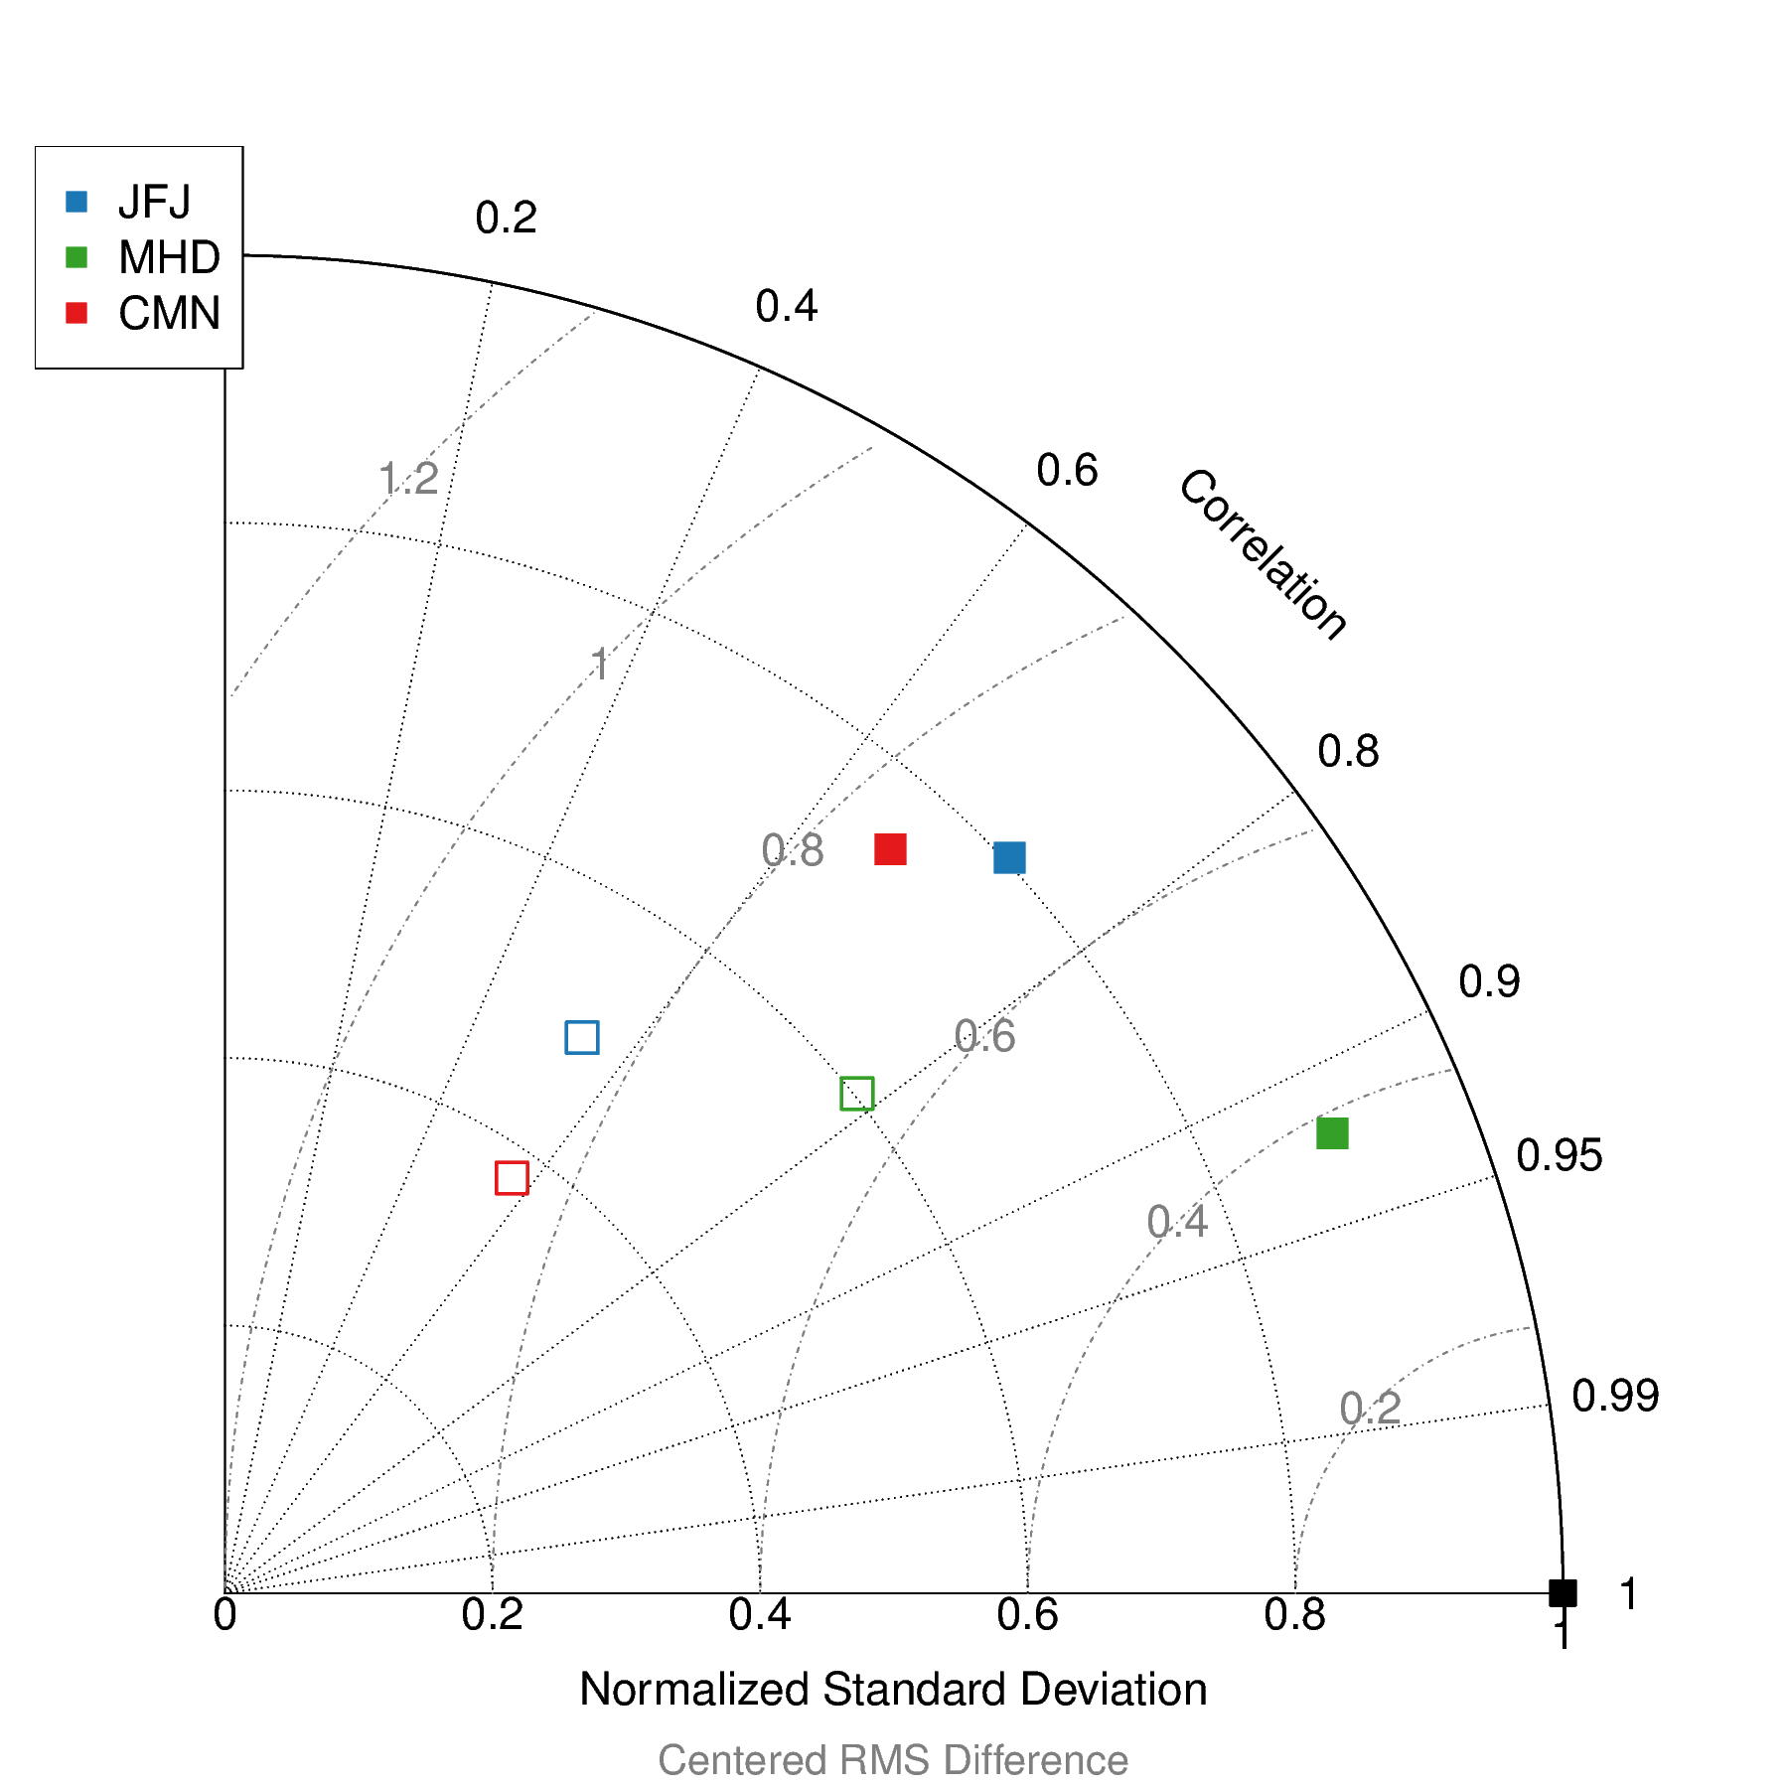
H11 vs. H14: Performance Analysis
H11
H14

Slide 18
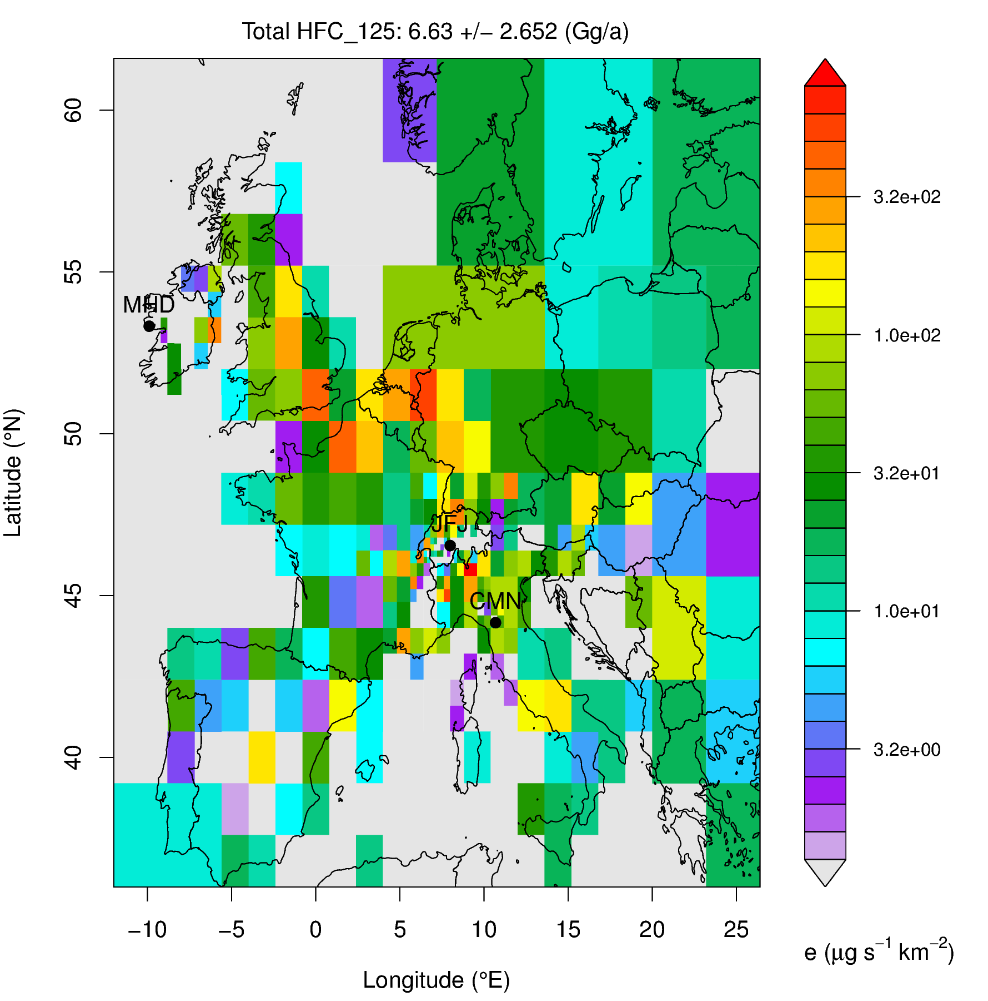
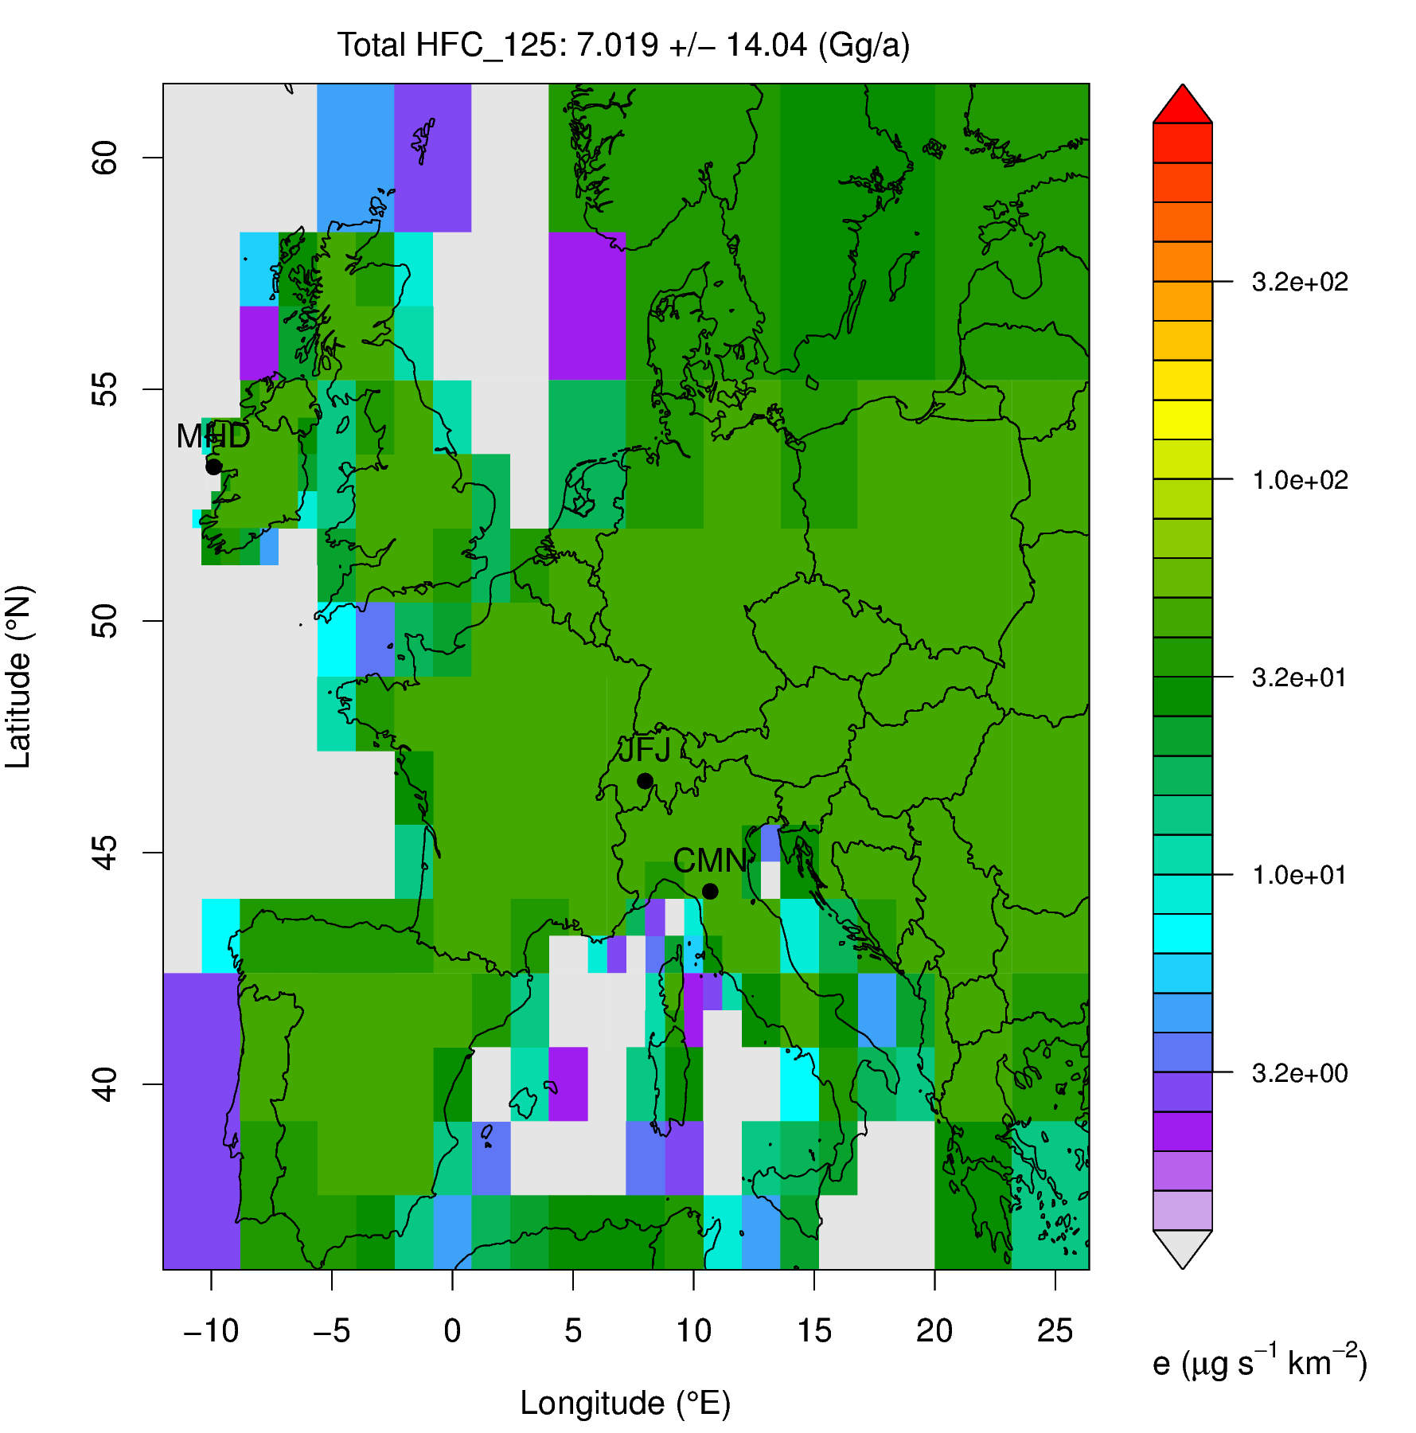
H11 vs. H14: Prior Emissions

Slide 19
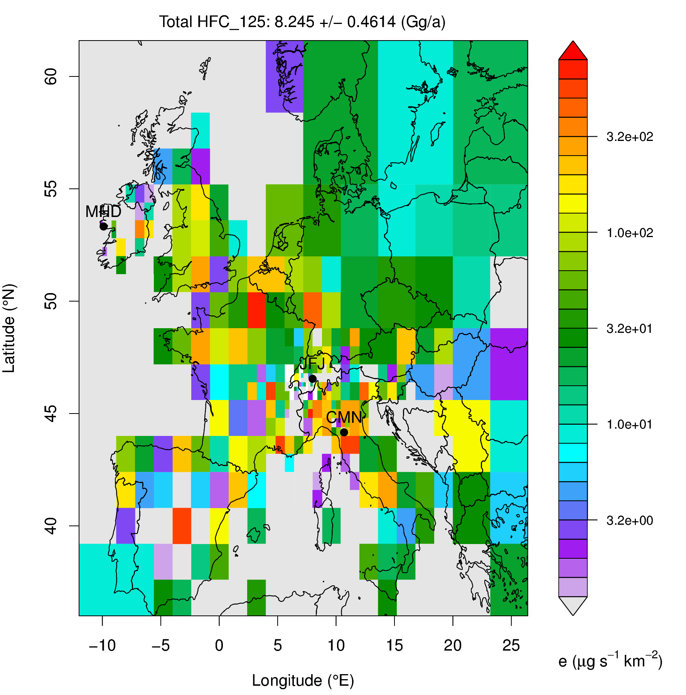
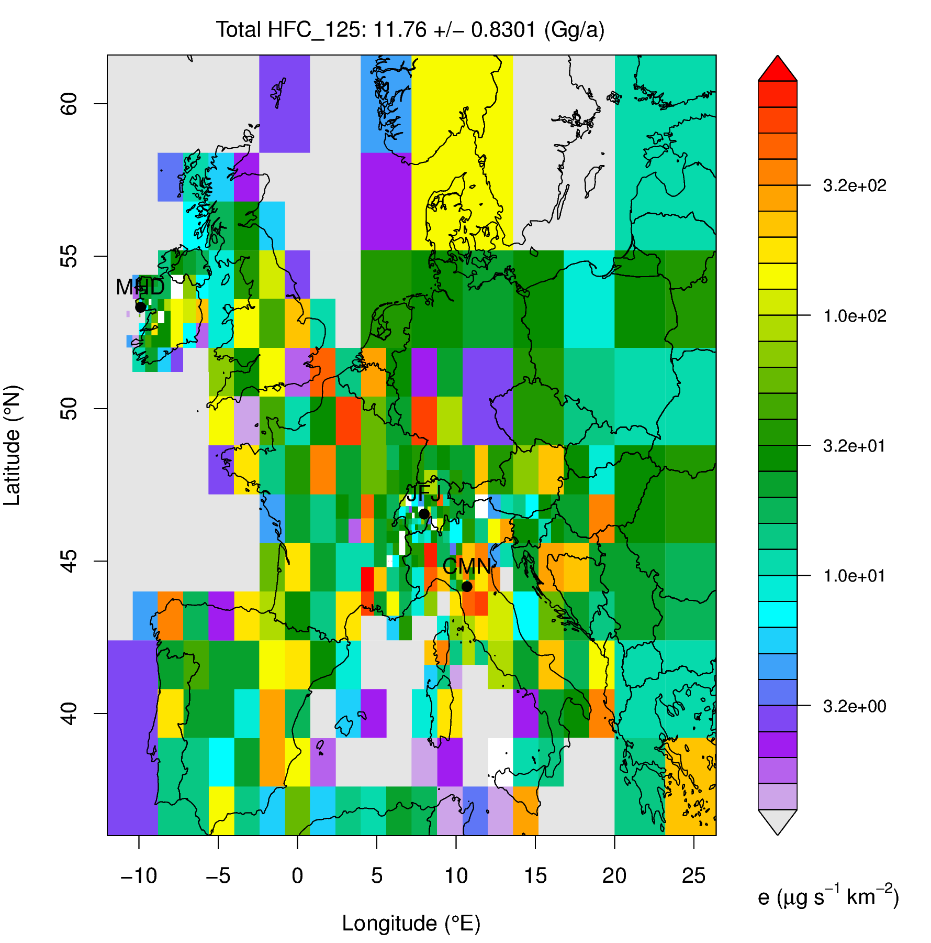
H11 vs H14: Posterior Emissions

Slide 20
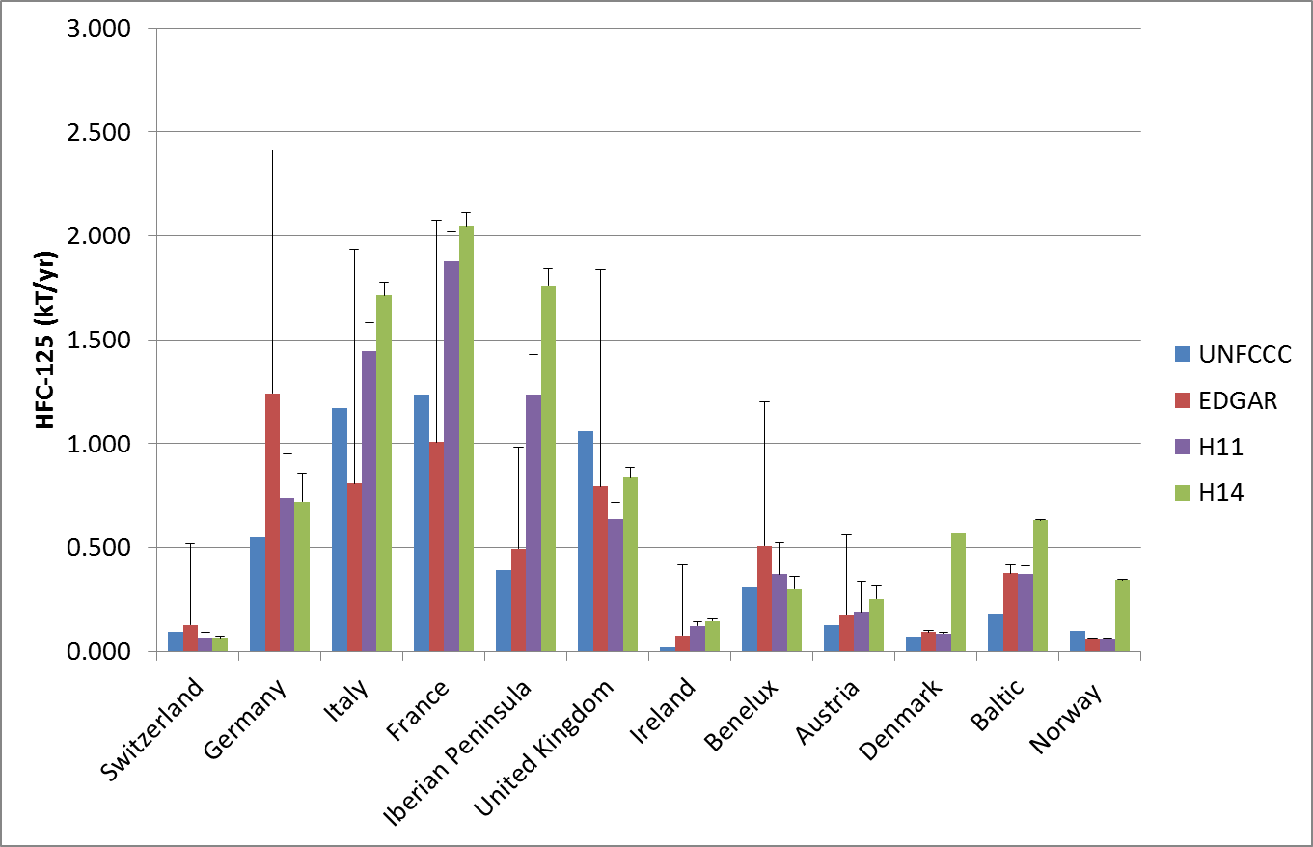
H11 vs. H14: National Totals

Slide 21
SF₆: Surface Sensitivities
HFC-125: MHD, JFJ, CMN
SF₆: MHD, JFJ

Slide 22
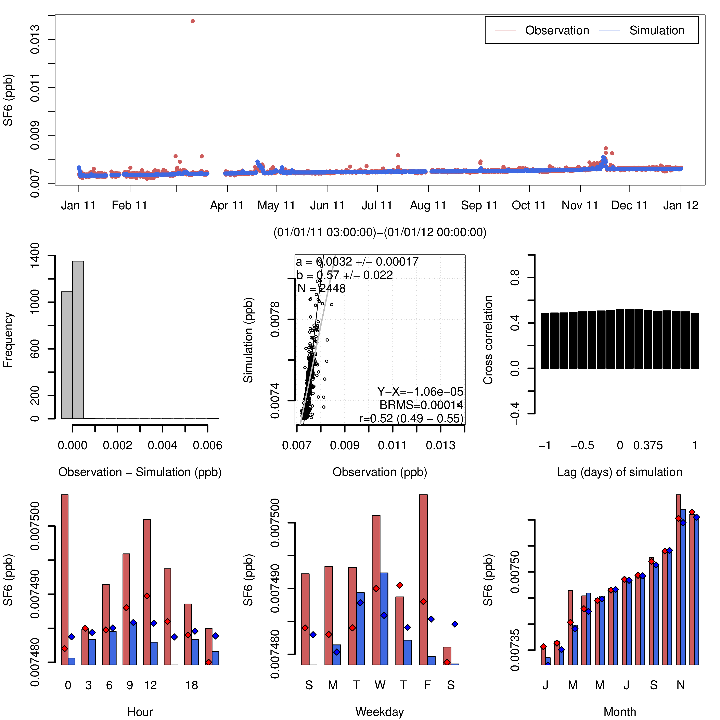
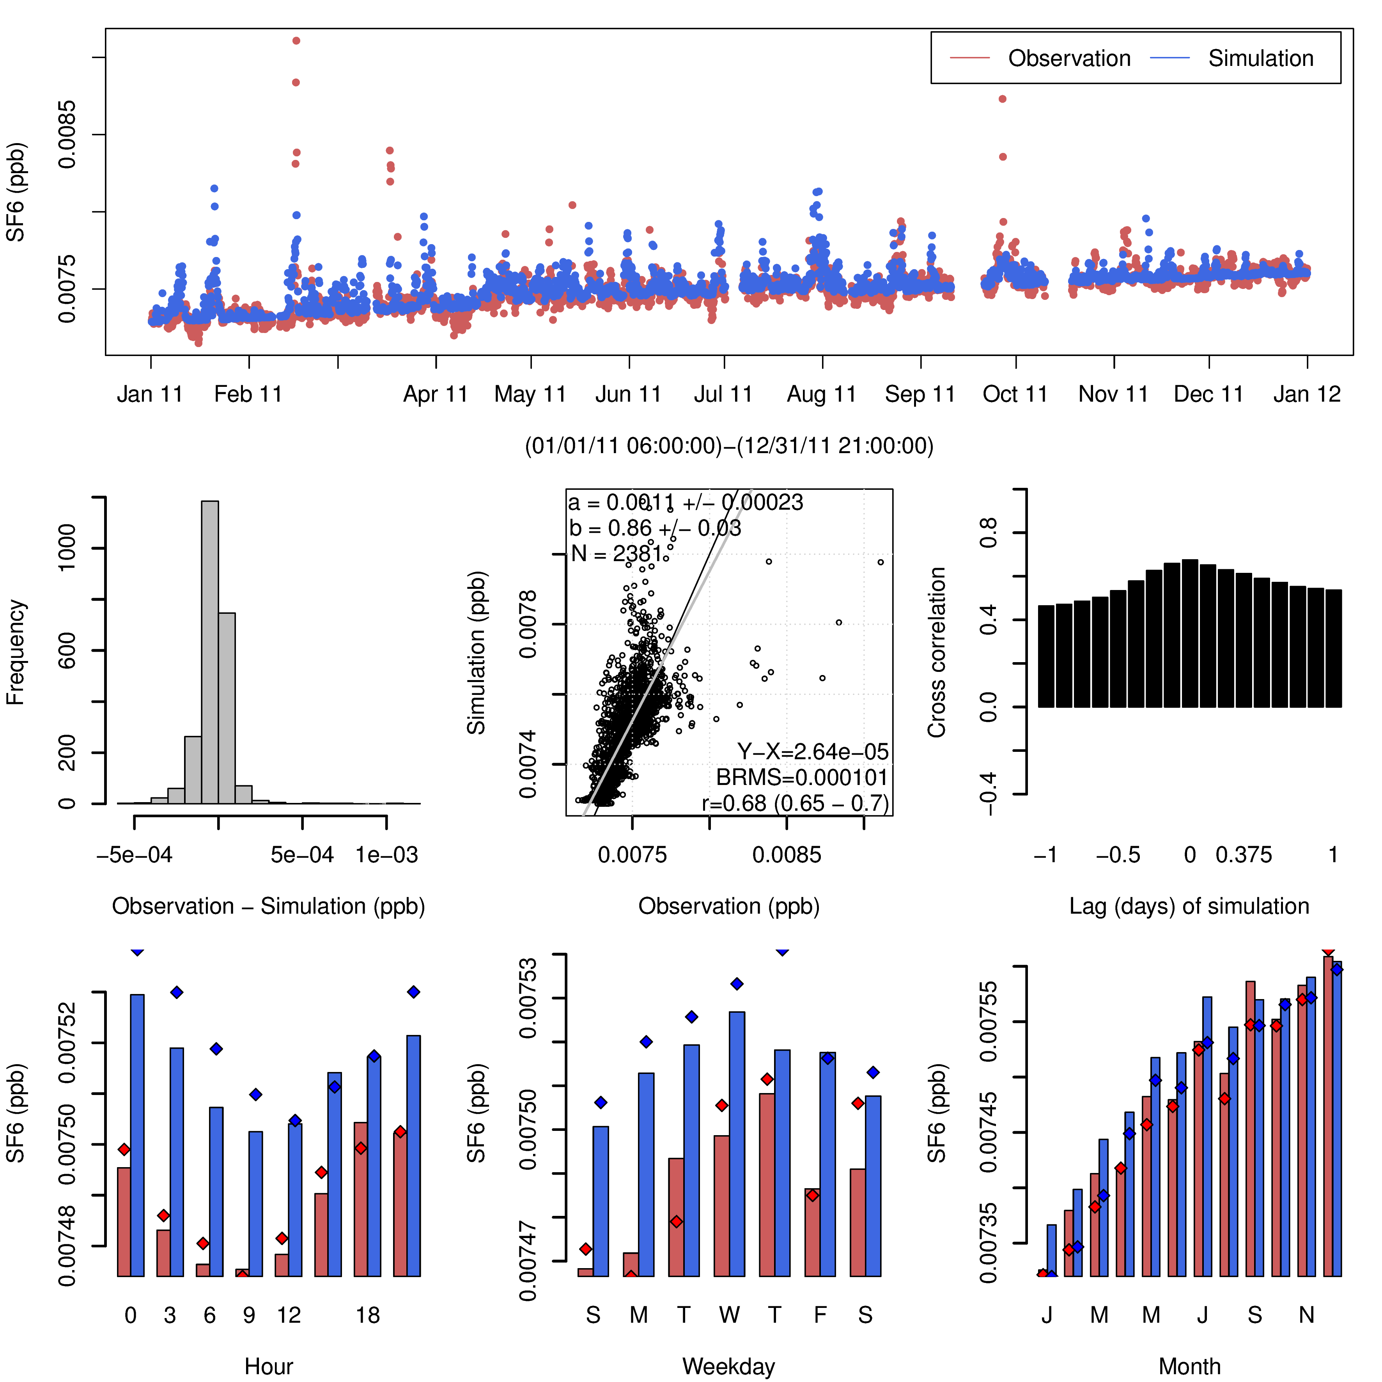
SF₆: Prior Time Series
Mace Head
Jungfraujoch

Slide 23
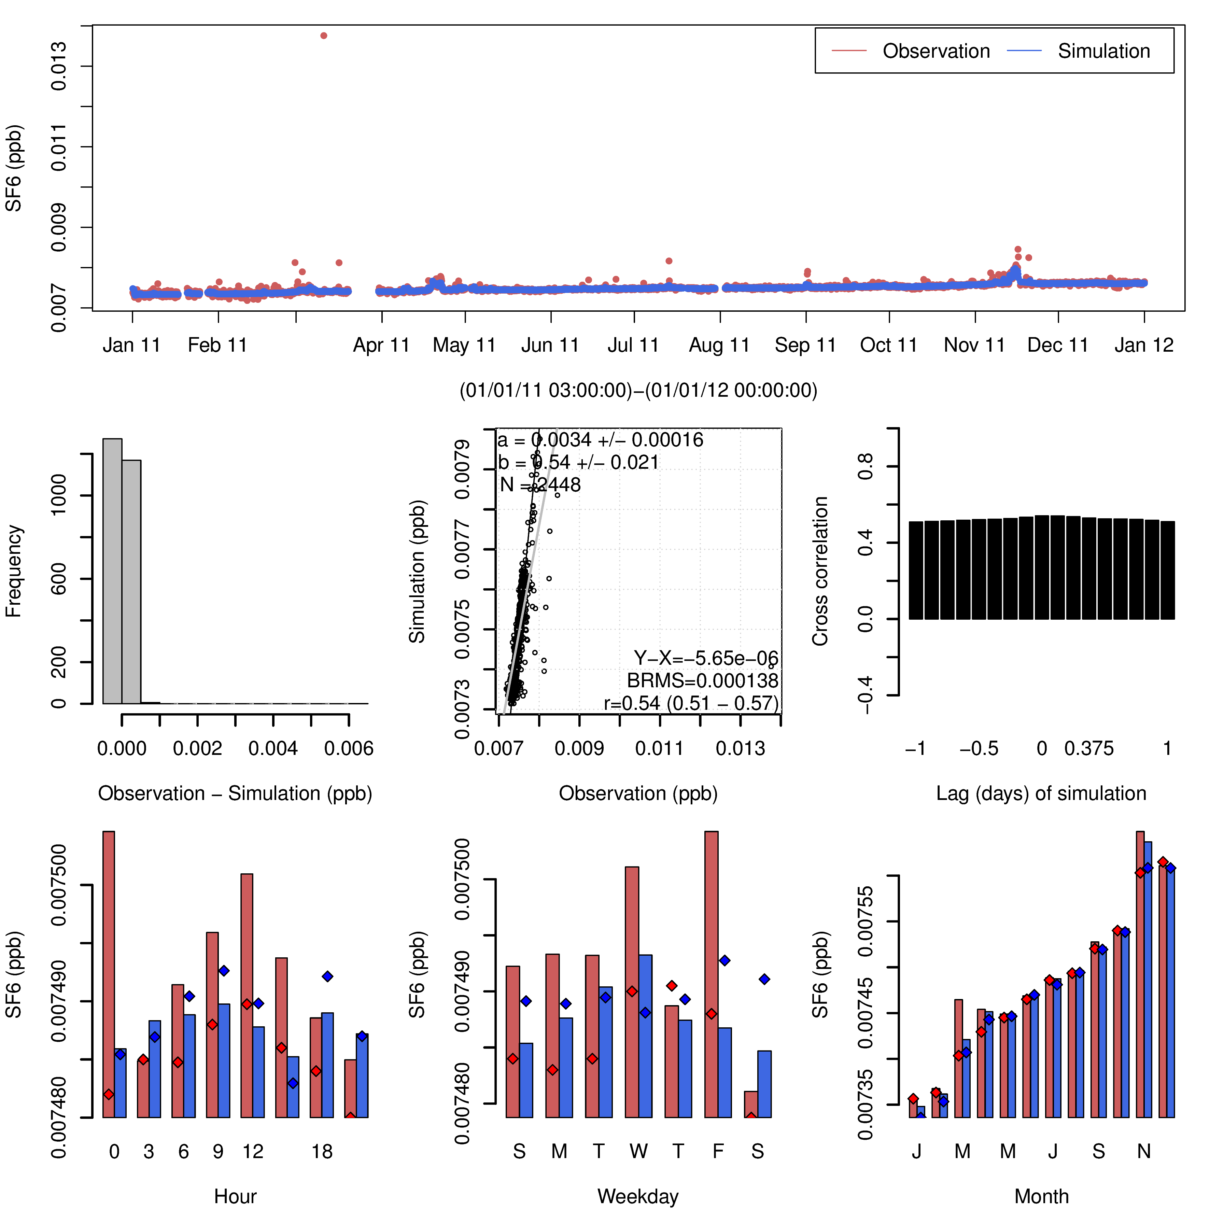
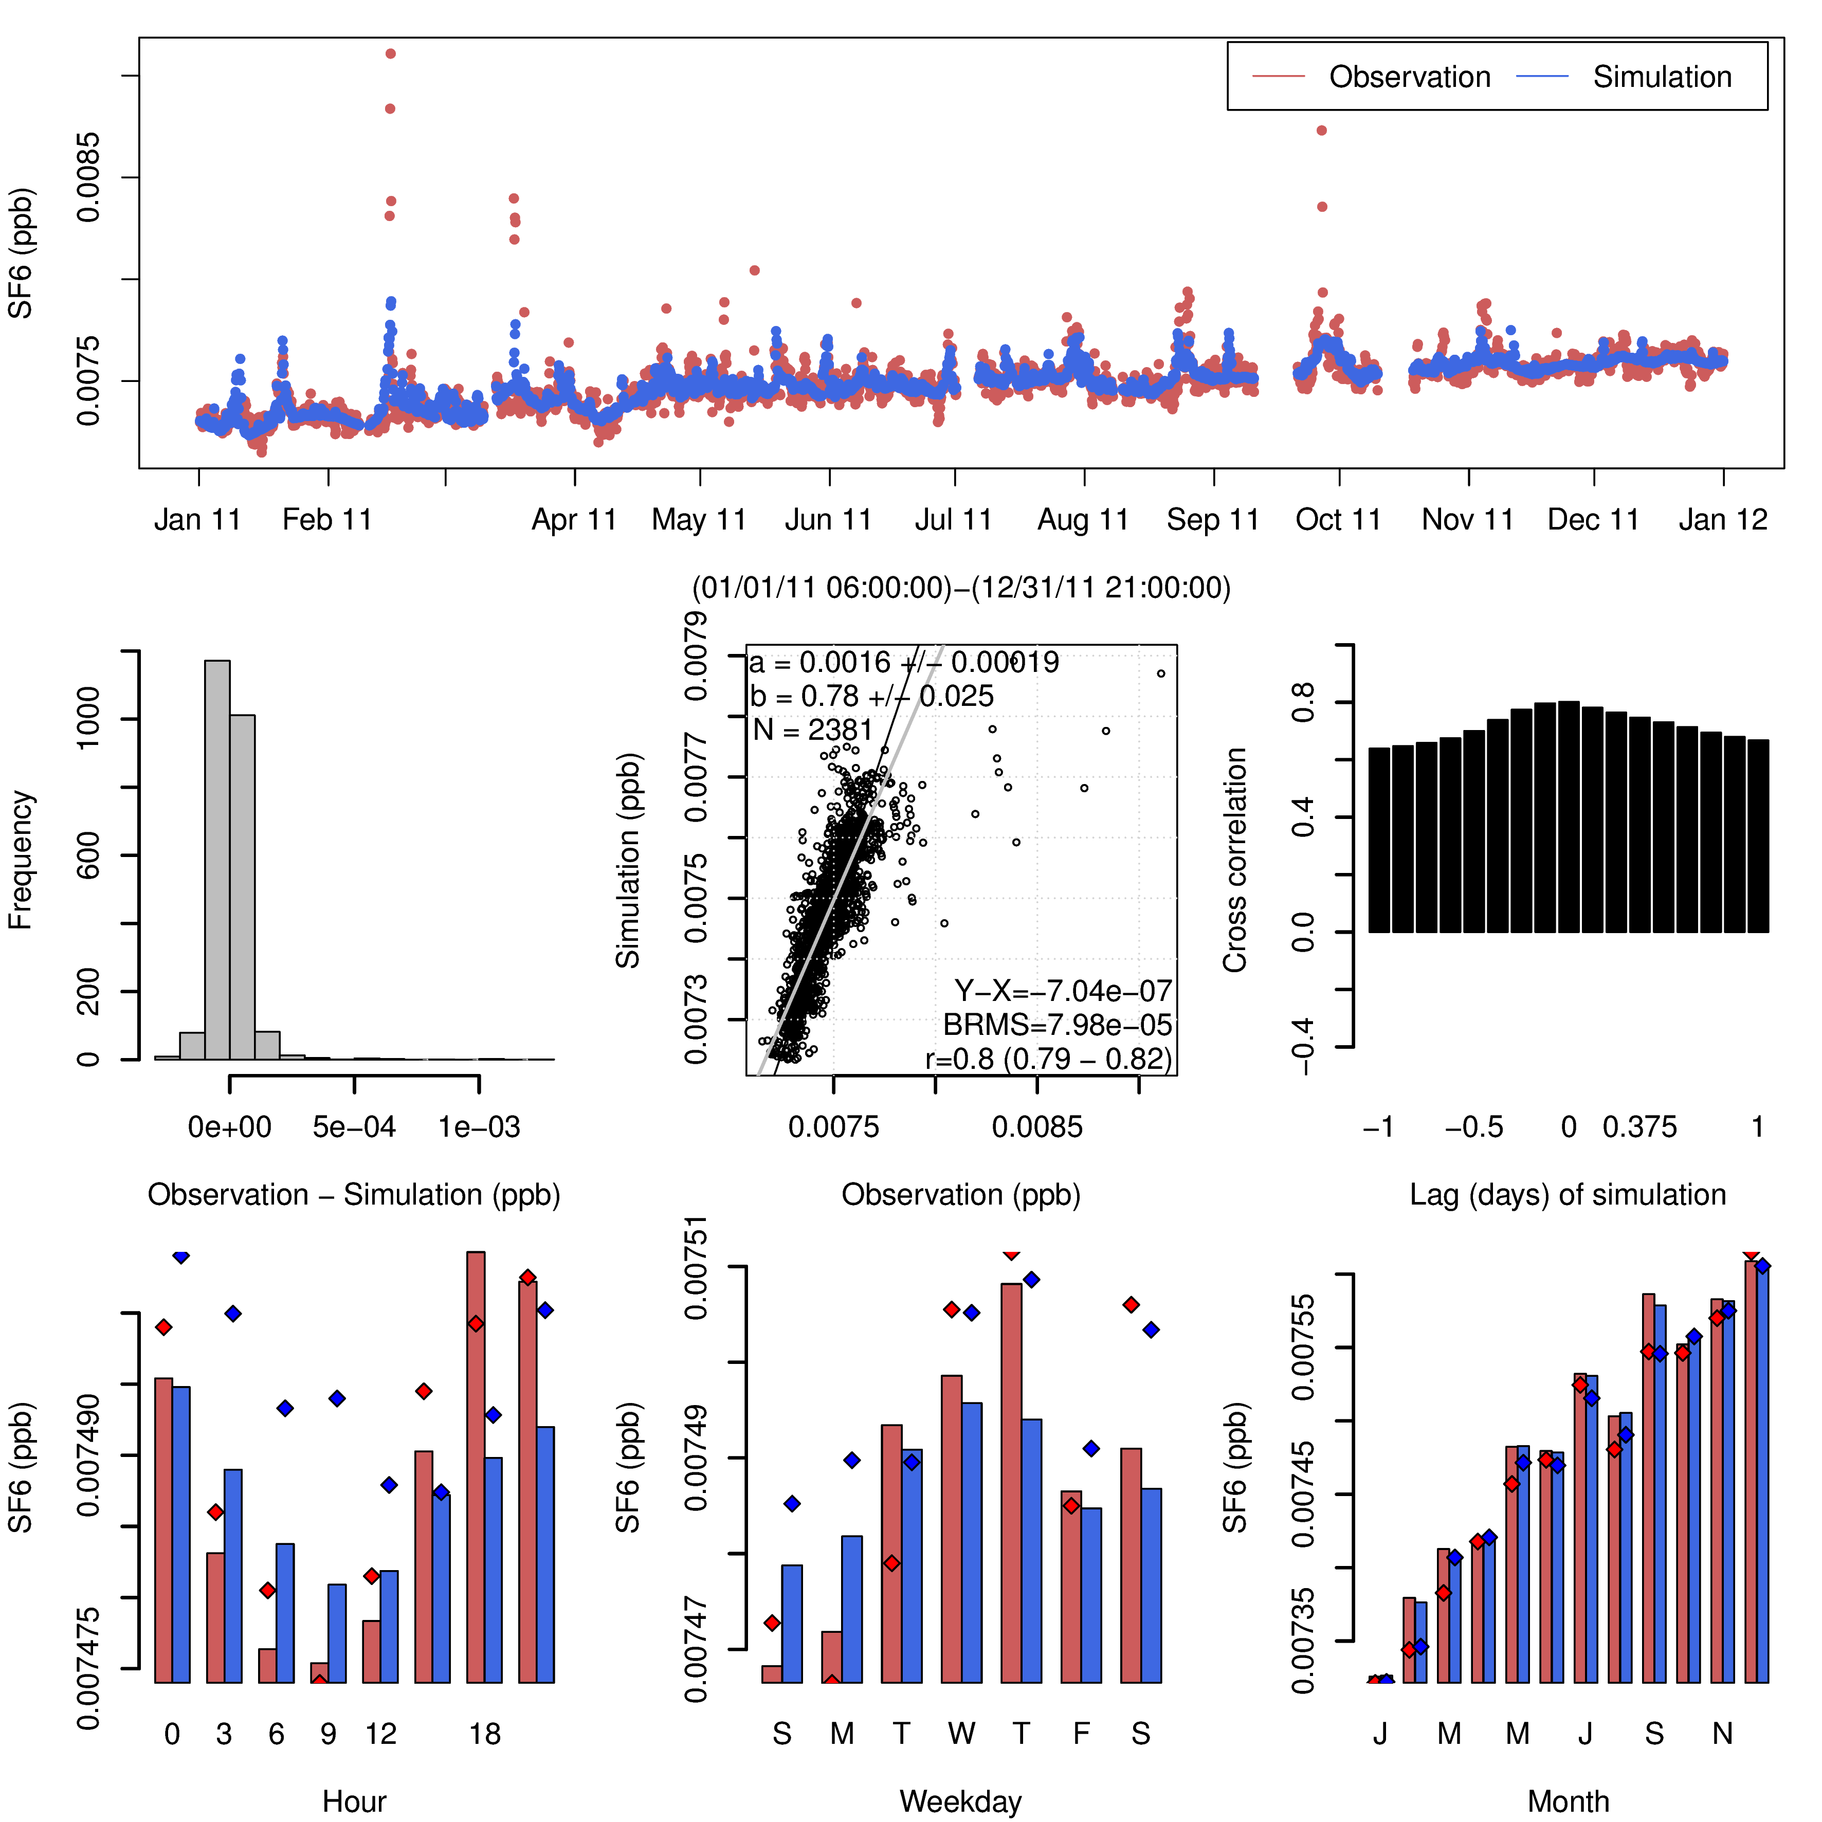
SF₆: Posterior Time Series
Mace Head
Jungfraujoch

Slide 24
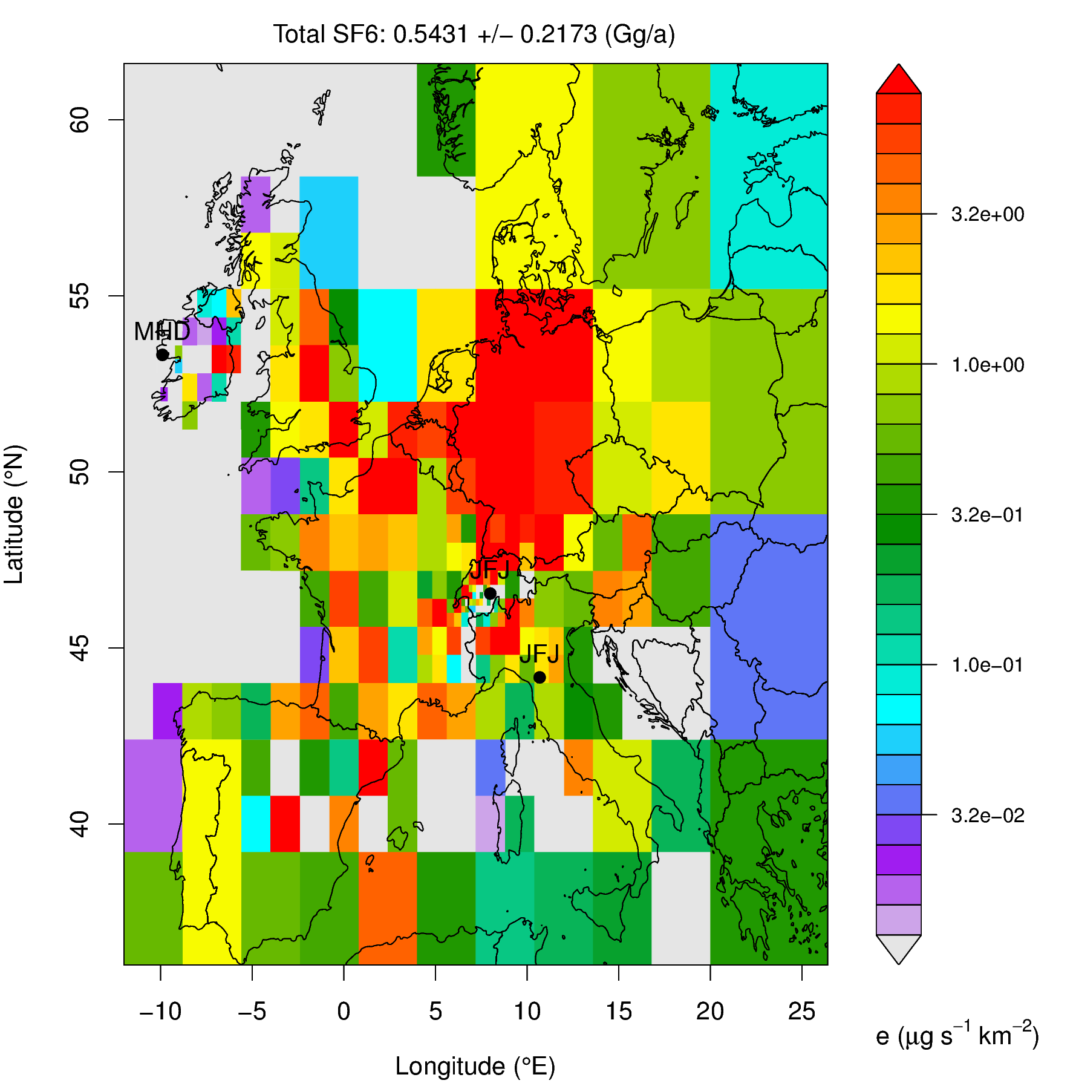
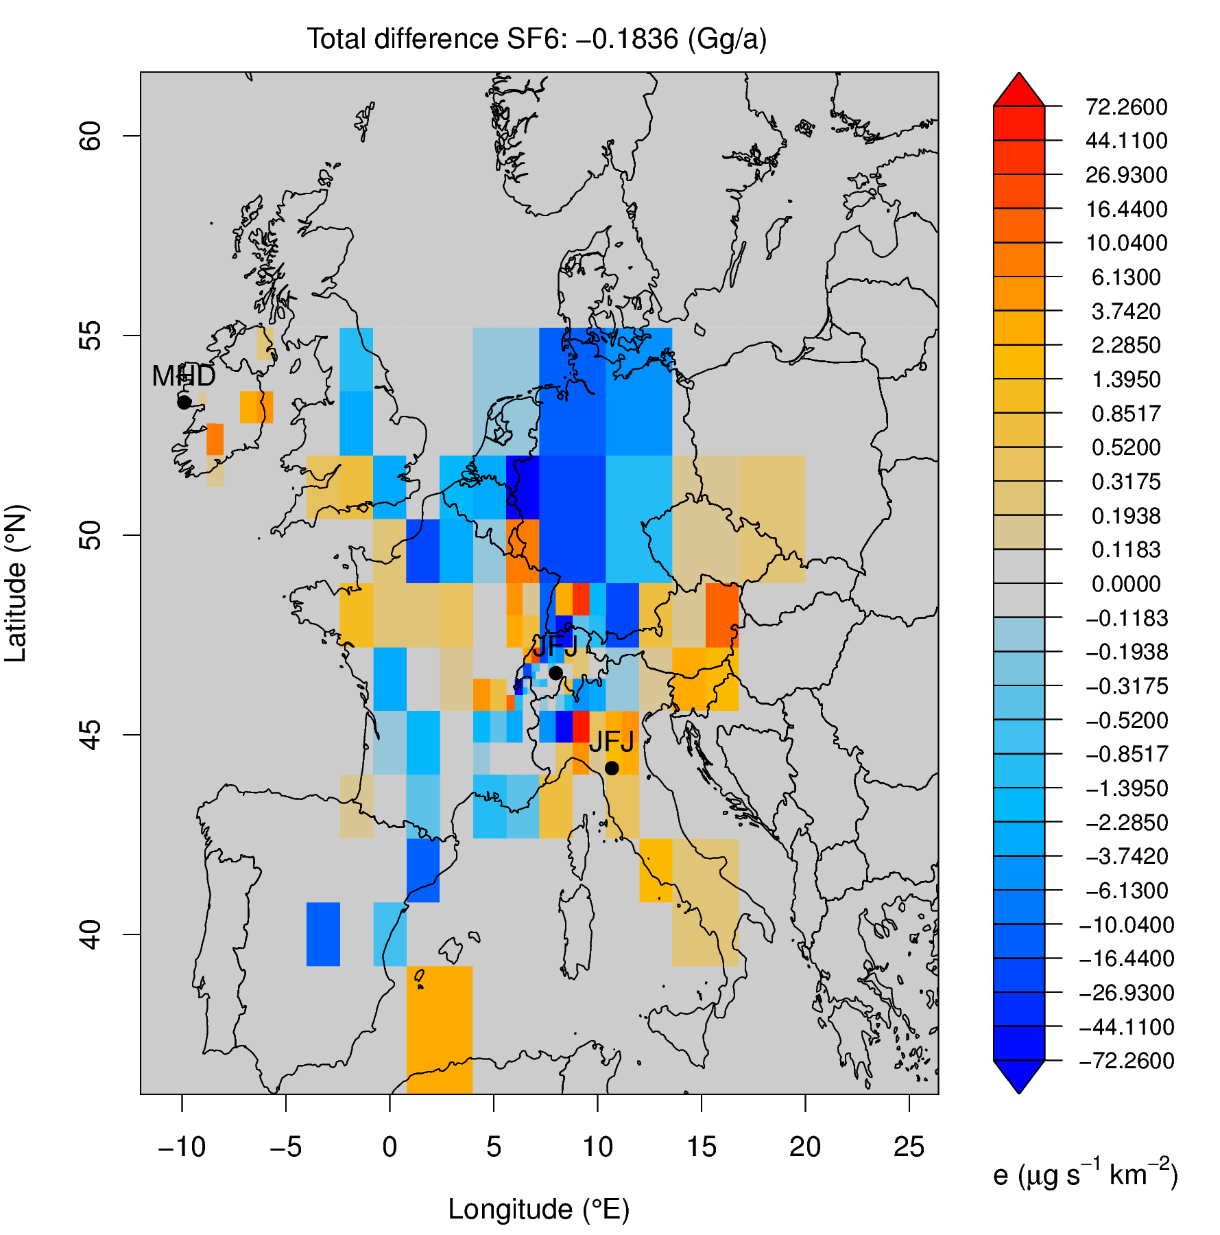
SF₆ Emission Adjustment
Prior emissions
Posterior emissions changes

Slide 25
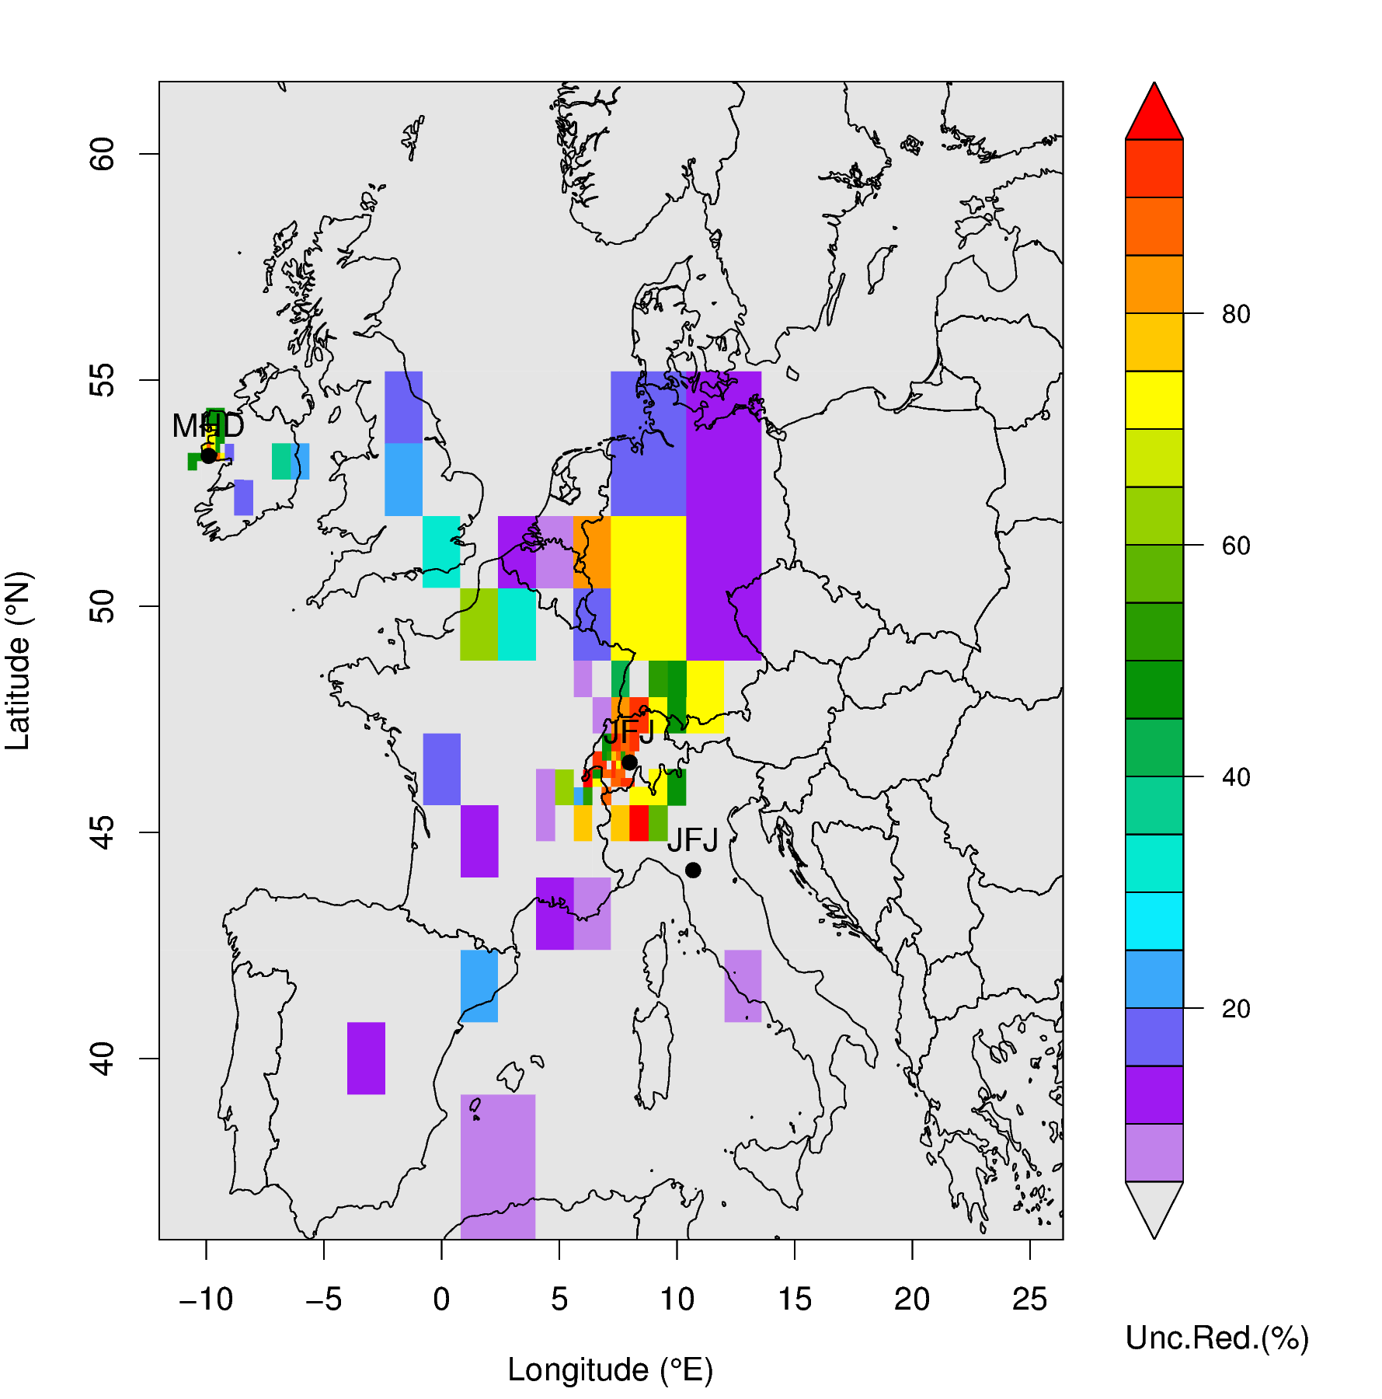
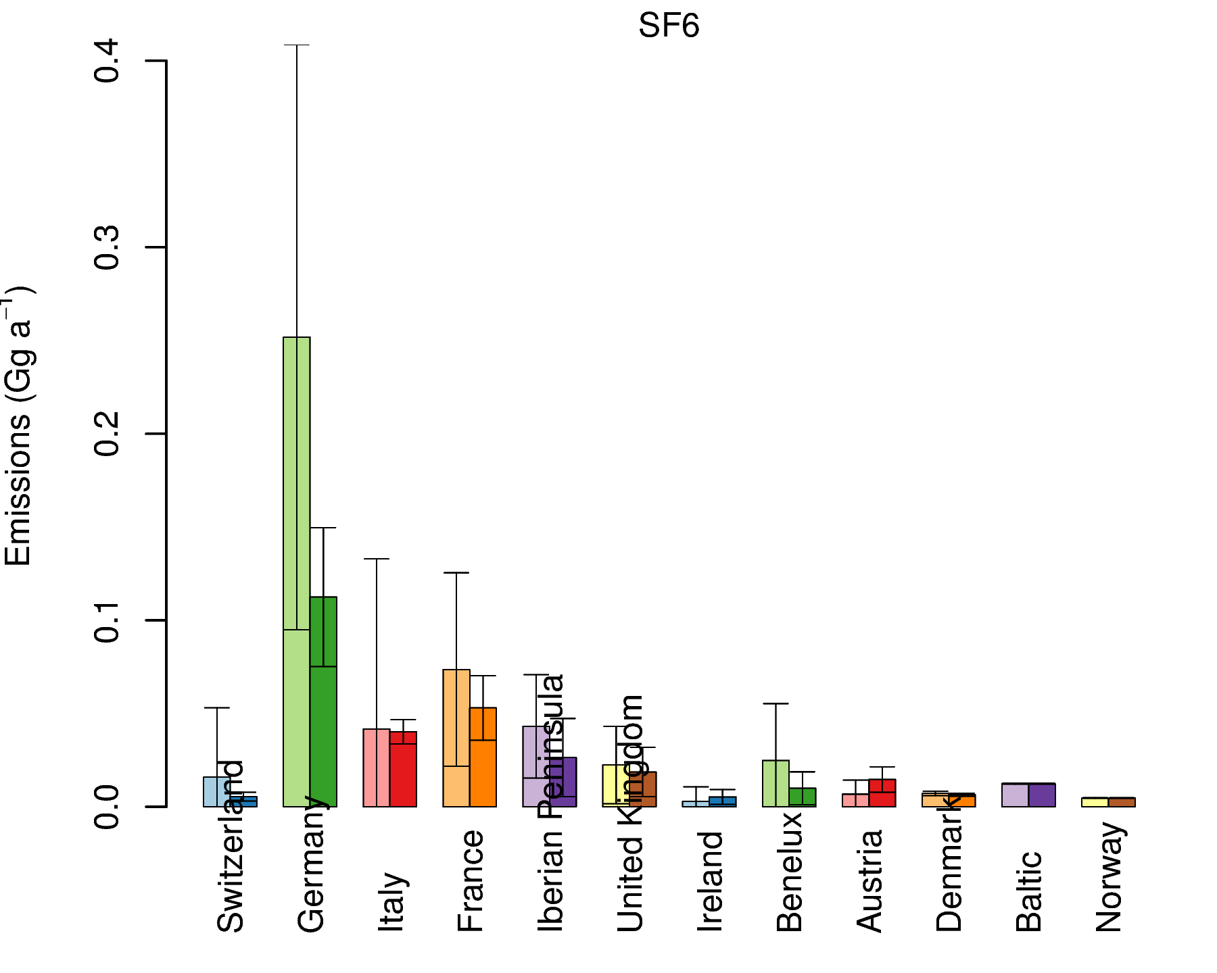
SF₆: National Totals
Uncertainty Reduction

Slide 26
Preliminary Conclusions From 2nd Experiment
HFC-125 and HFC-134a (H11, H12): minor changes from 1st experiments
H11 vs. H14
Similar results with constant a-priori instead of EDGAR a-priori (Empa2)
Larger increases in FR, ES, IT for H14 (Empa2)
SF₆ (Empa2)
Limited sensitivity to Spain, Portugal and Southern Italy
Emission reduction in CH, DE
Emission reduction in ES, FR, but large uncertainty remaining
Emissions confirmed in IT

Slide 27
Outlook
Final agreement on settings for 2nd experiment
Update on EDGAR 4.2_FT2010?
Deduction of national emissions and their uncertainties
Regular grid uncertainties
Results of 2nd experiment submitted to Empa by 1 Jan 2015 (ALL, D15.11, M42)
Draft of inter-comparison report prepared for reviewing within Task by 1 Apr 2015 (Empa, D15.14, M45)

