Slide 1
Atmospheric modeling of the δ¹³C-CH₄ variability at European measurement sites
Guillaume Monteil^{(1,2)}, Sander Houweling^{(2,1)}, Thomas Röckmann⁽¹⁾
Marielle Saunois⁽³⁾, Philippe Bousquet⁽³⁾
IMAU, Utrecht, The Netherlands
SRON, Utrecht, The Netherlands
LSCE, Gif-sur-yvette, France

Slide 2
δ¹³C-CH₄ in the InGOS project
Objectives:
Investigate the potential of ICOS extension with high frequency δ¹³C-CH₄ measurements.
How useful δ¹³C-CH₄ really is?
Are the model and data precise enough?
Tasks:
Develop demonstration instrument
TM5 simulations of CH₄ and δ¹³C-CH₄ to assess the potential contribution of European sources to the measurements, and the uncertainties

Slide 3
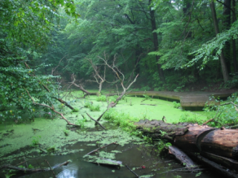
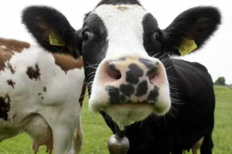
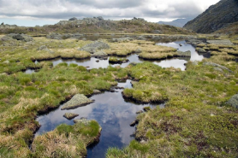
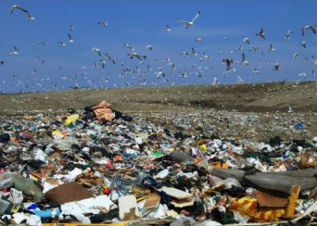
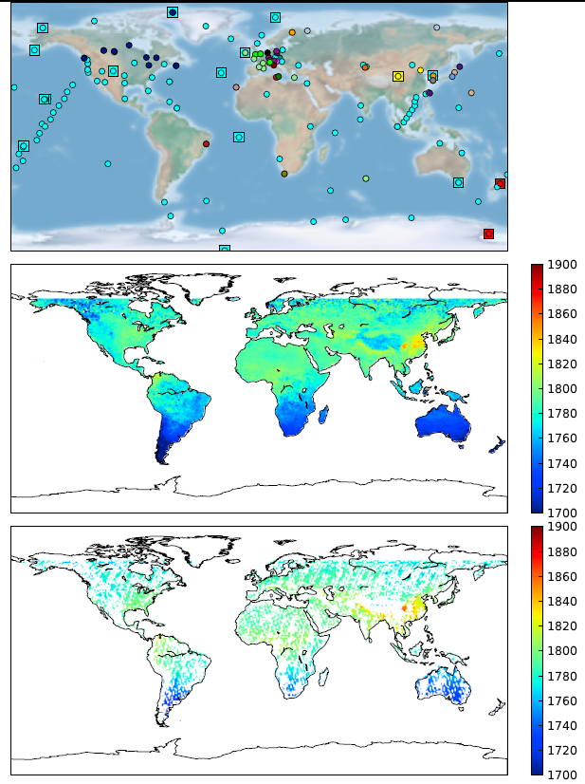
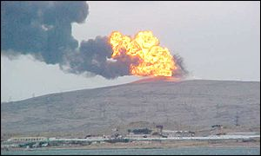
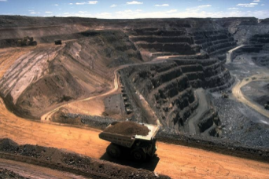
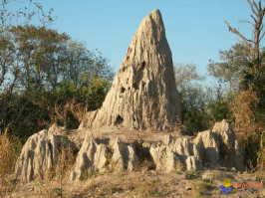
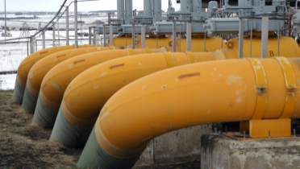
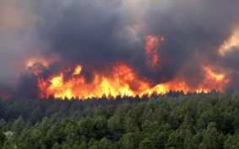
Why looking at δ¹³C-CH₄?
Good observational constraint on the total CH4 source
Poor constraint on the source distribution

Slide 4
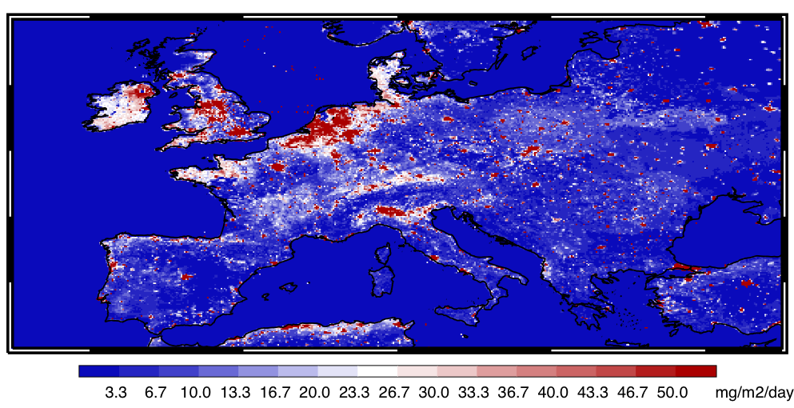
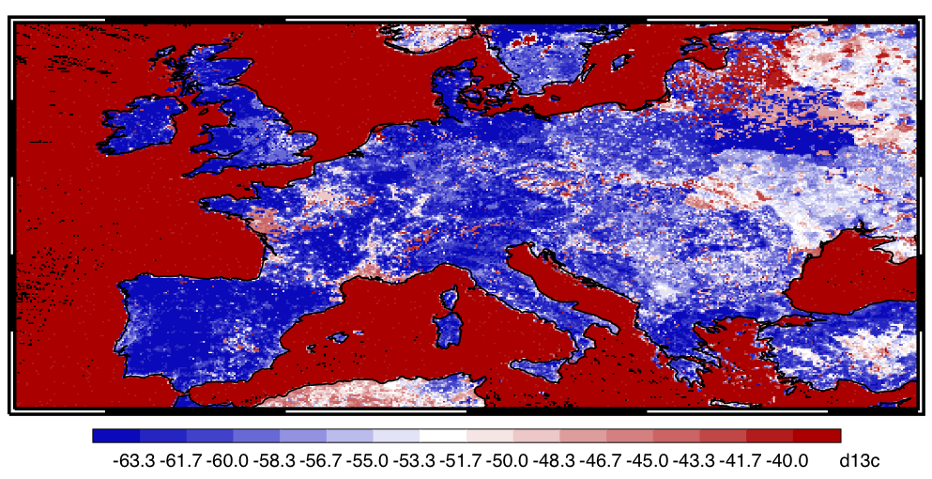
Why looking at δ¹³C-CH₄?
Patterns of CH4 and d13C-CH4 differ significantly ➔ potentially useful information
Methodology:
Build a CH4 sources/sinks budget, and attribute their isotopic signatures
Generate a base simulation
Perform sensitivity simulations
No emissions in Europe (evaluate the background)
Only anthropic or only natural emissions
Switch off one single source at a time
Uncertainty estimation
Intercomparison with LMDz (transport model errors)
Propagation of uncertainties in source signatures to modelled mixing and isotopic ratios.

Slide 5
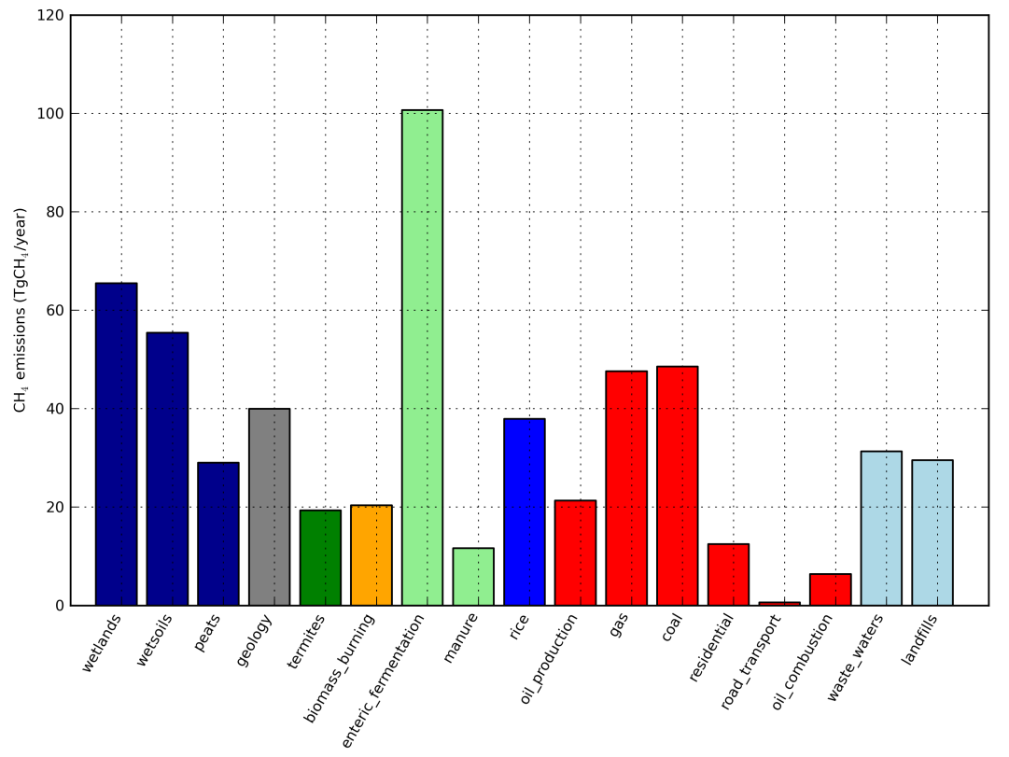
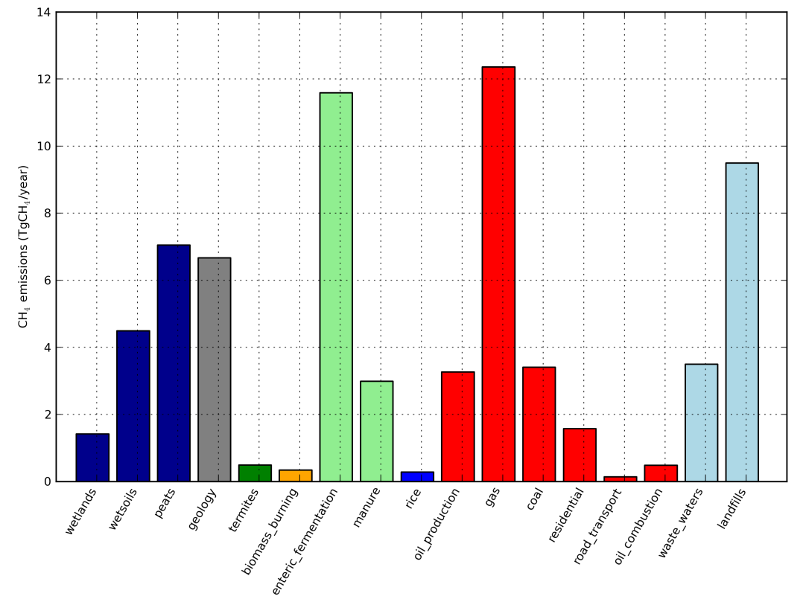
Base CH4 budget
Anthropogenic sources: EDGAR4.2FT
Natural wetland emissions: LPG-WhyMe
Geologic emissions: GLOGOSS database + scaling to 40 TgCH4/year
+ minor sources (termites, wild animals …)

Slide 6
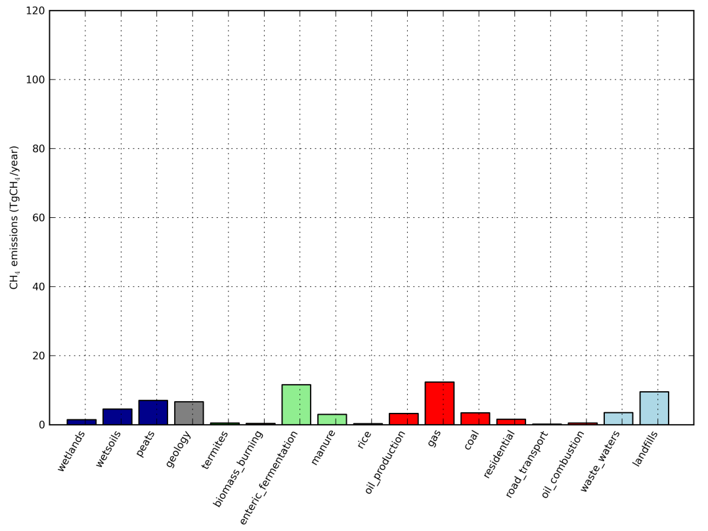
Base CH4 budget
Anthropogenic sources: EDGAR4.2FT
Natural wetland emissions: LPG-WhyMe
Geologic emissions: GLOGOSS database + scaling to 40 TgCH4/year
+ minor sources (termites, wild animals …)
Can we distinguish the (individual) European CH4 sources from the background?

Slide 7
d13C source signatures
Well known (±2‰):
Wetlands
Biomass burning
Enteric fermentation/manure
Oil and Gas
Less well known (±4‰):
Rice
Geology
Termites
Landfills
Coal
Poorly known (±6‰):
Waste water treatment

Slide 8
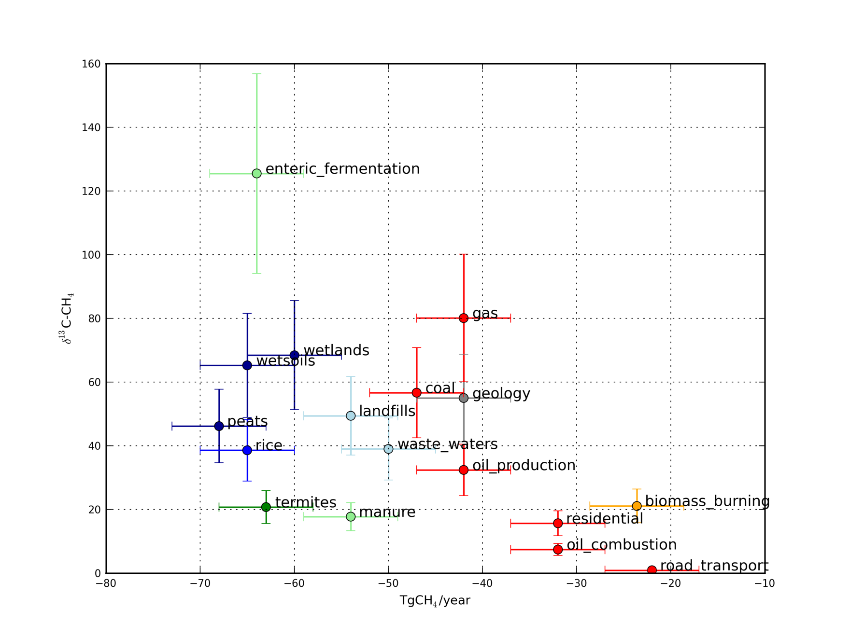
Base CH4 budget: source signatures

Slide 9
TM5 model
6°x4° global resolution, 1°x1° zoom over Europe
Transported tracers: CH4 and 13CH4. d13C-CH4 reconstructed afterwards
Initial condition: 25 years spinup run with emissions and sinks kept constant
Base simulation from 2005 to 2009
Sensitivity runs from January to December 2009

Slide 10
δ¹³C-CH₄ in the InGOS project
High-frequency observations (1/hour) across Europe
Needed: a map of the InGOS network and an example of measured time-series
Objectives:
Better constrain the European CH4 budget
Improve our knowledge of source signatures ➔ applicable to other regions.
Work to be done:
What precision is needed to provide useful model results?
Evaluation of the uncertainties
Overarching goal: determine whether we can learn something from δ¹³C-CH₄ that we couldn’t learn from CH4.

Slide 11
TM5 model

Slide 12
TM5 model

Slide 13
Measurement sites

Slide 14
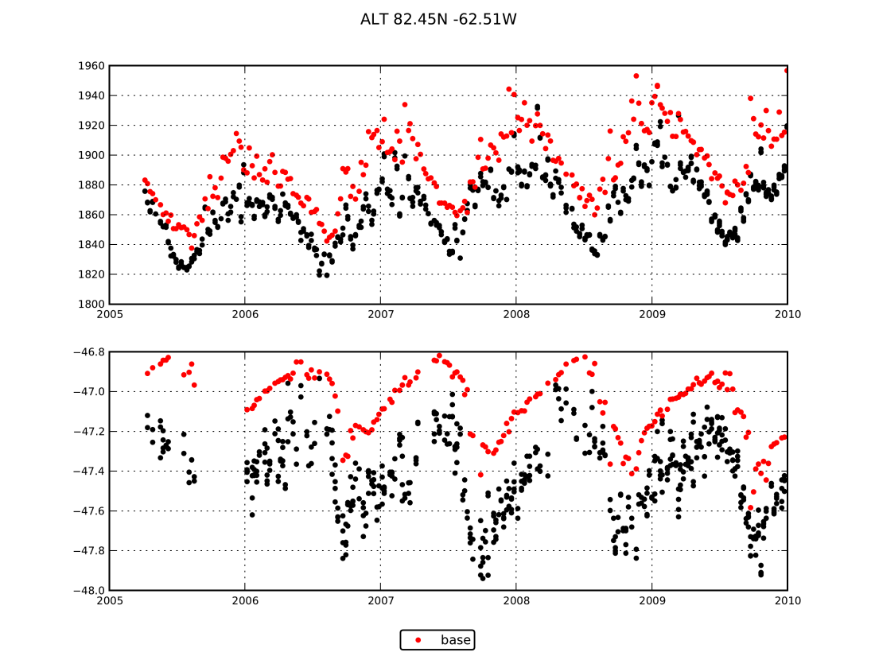
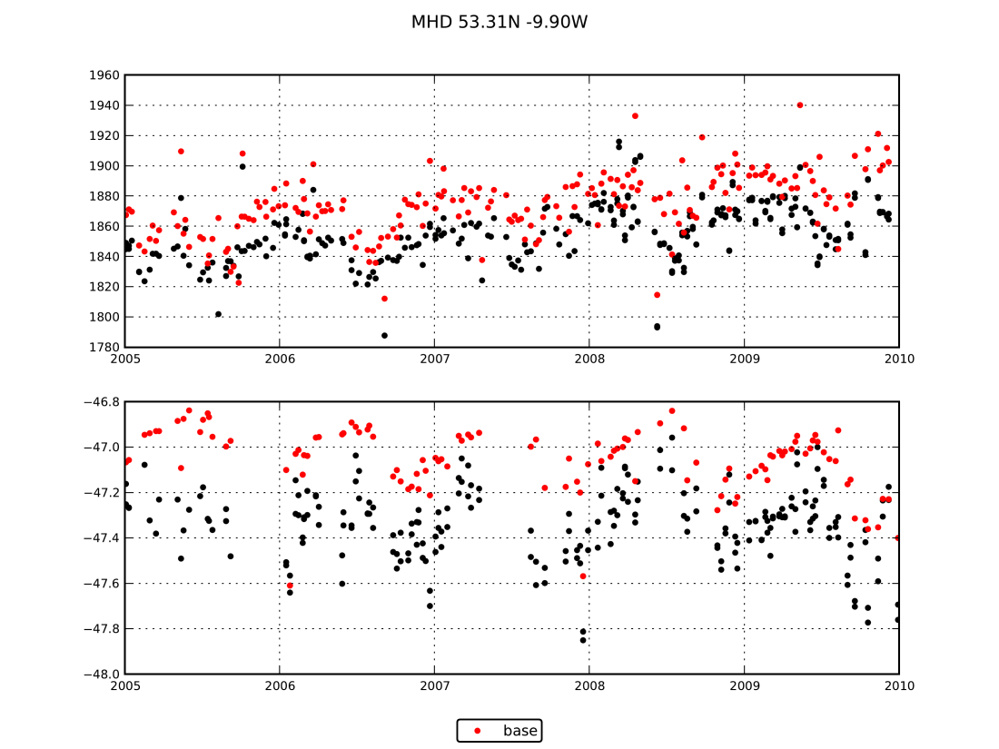
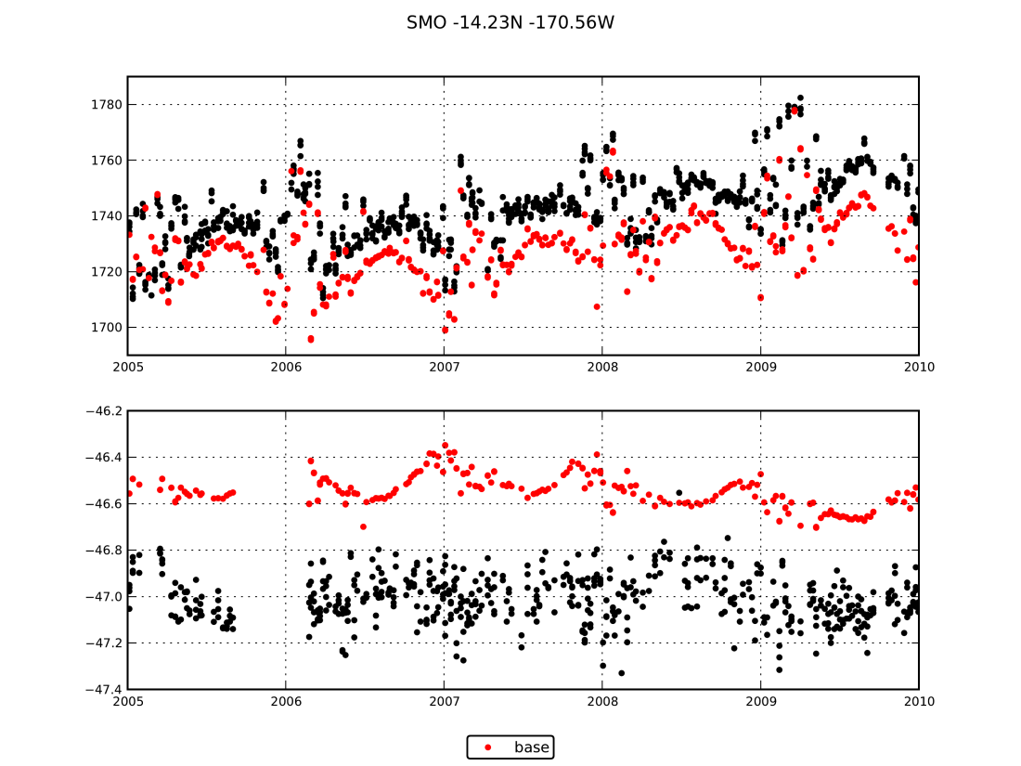
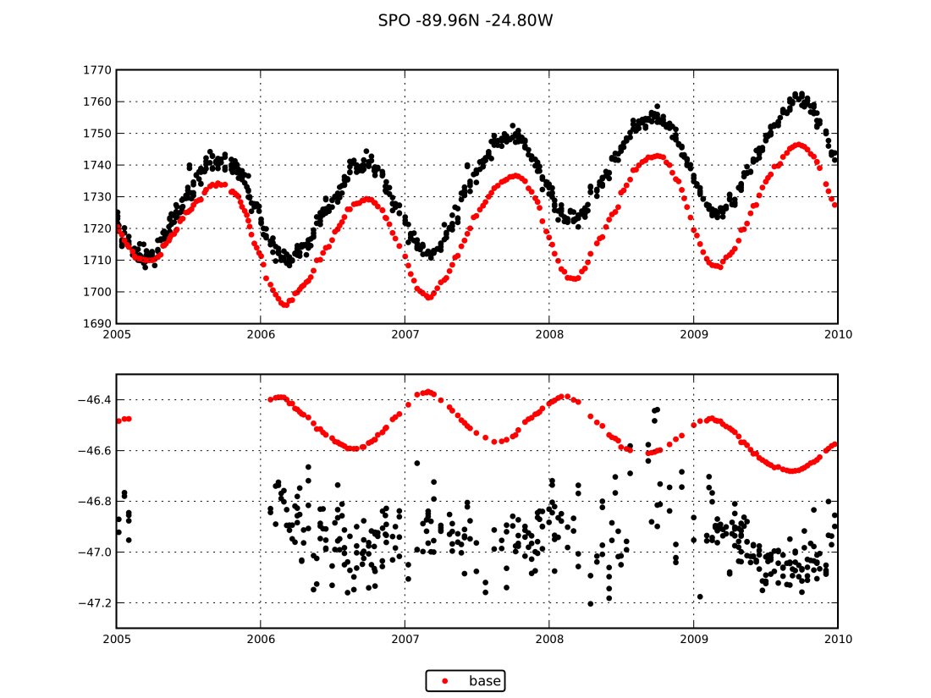
Results: base scenario

Slide 15
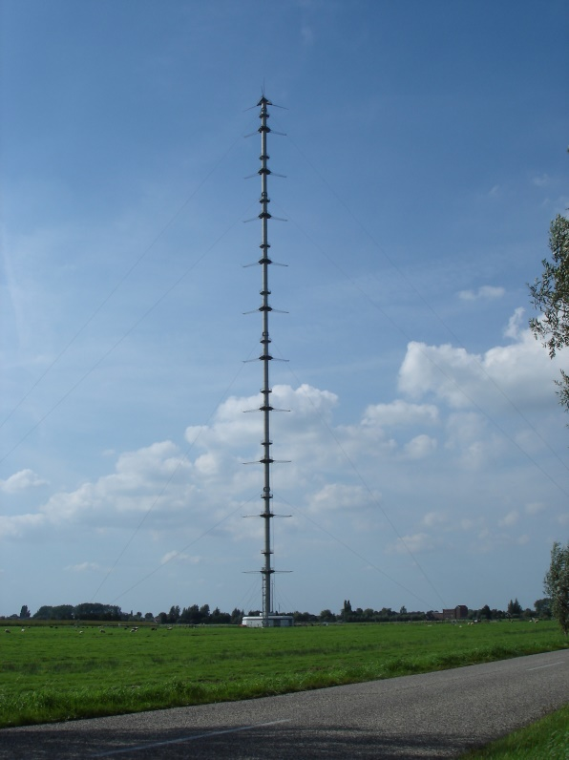
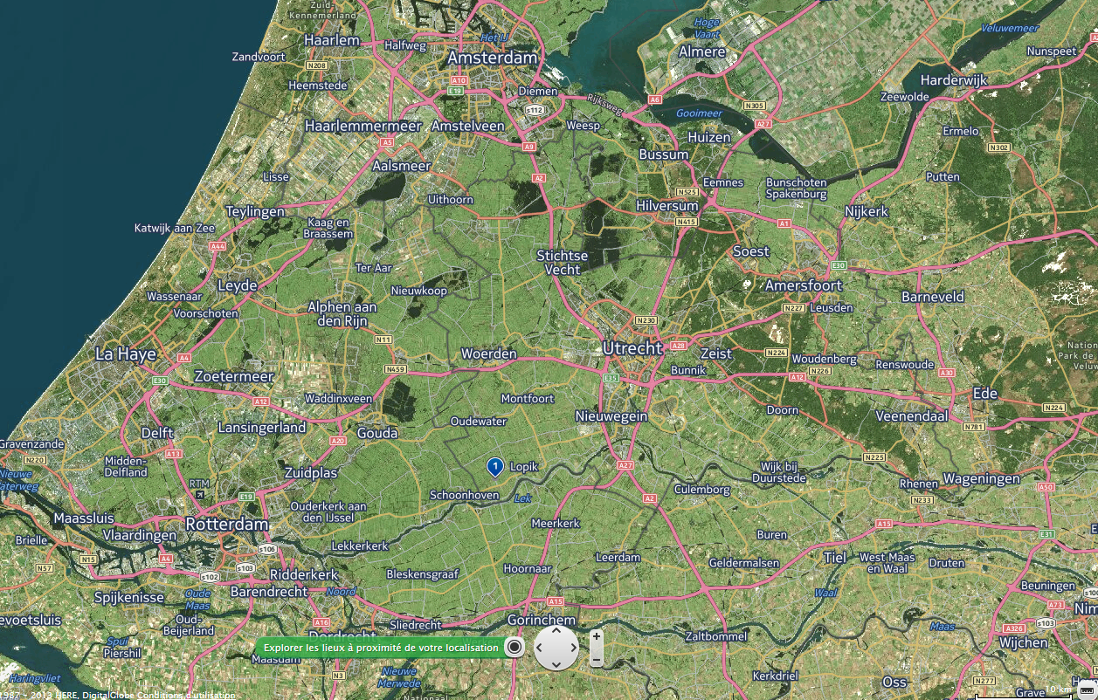
Cabauw tower

Slide 16
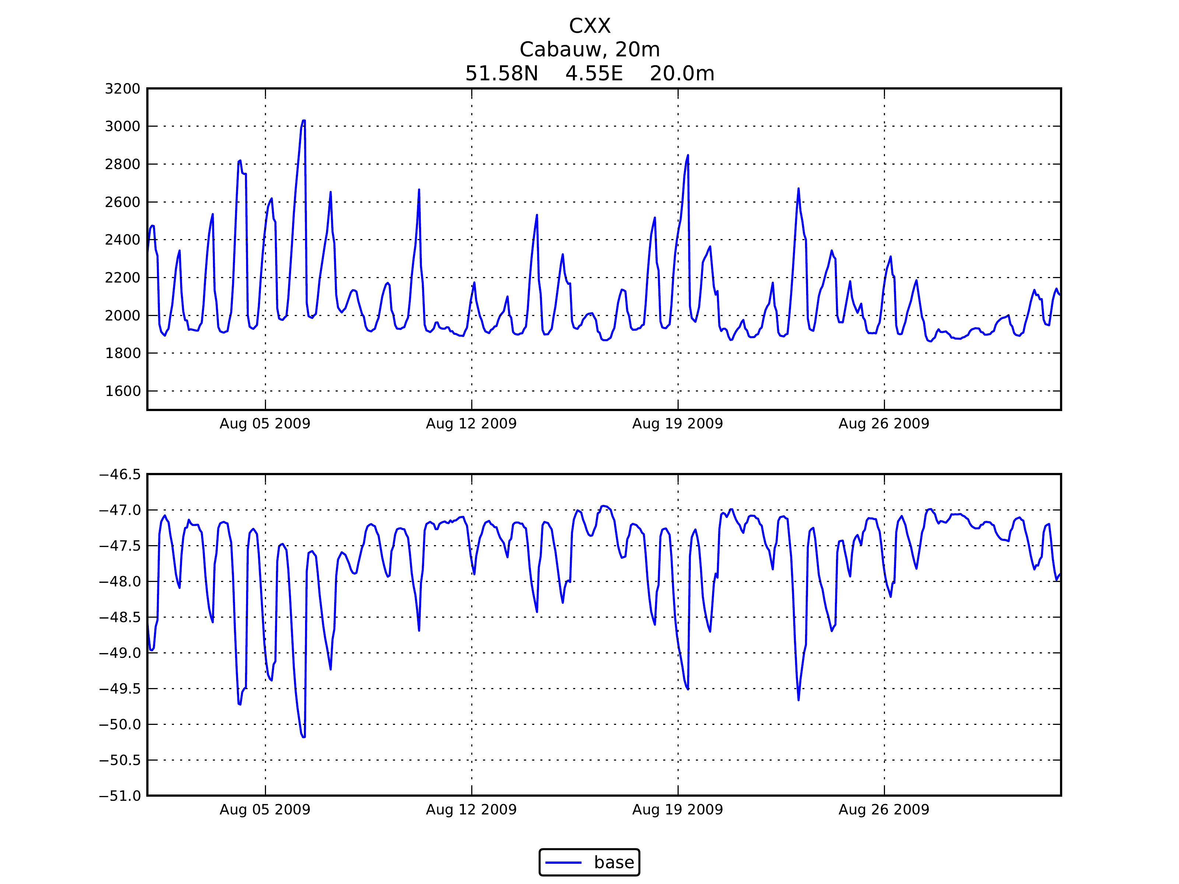
Base scenario

Slide 17
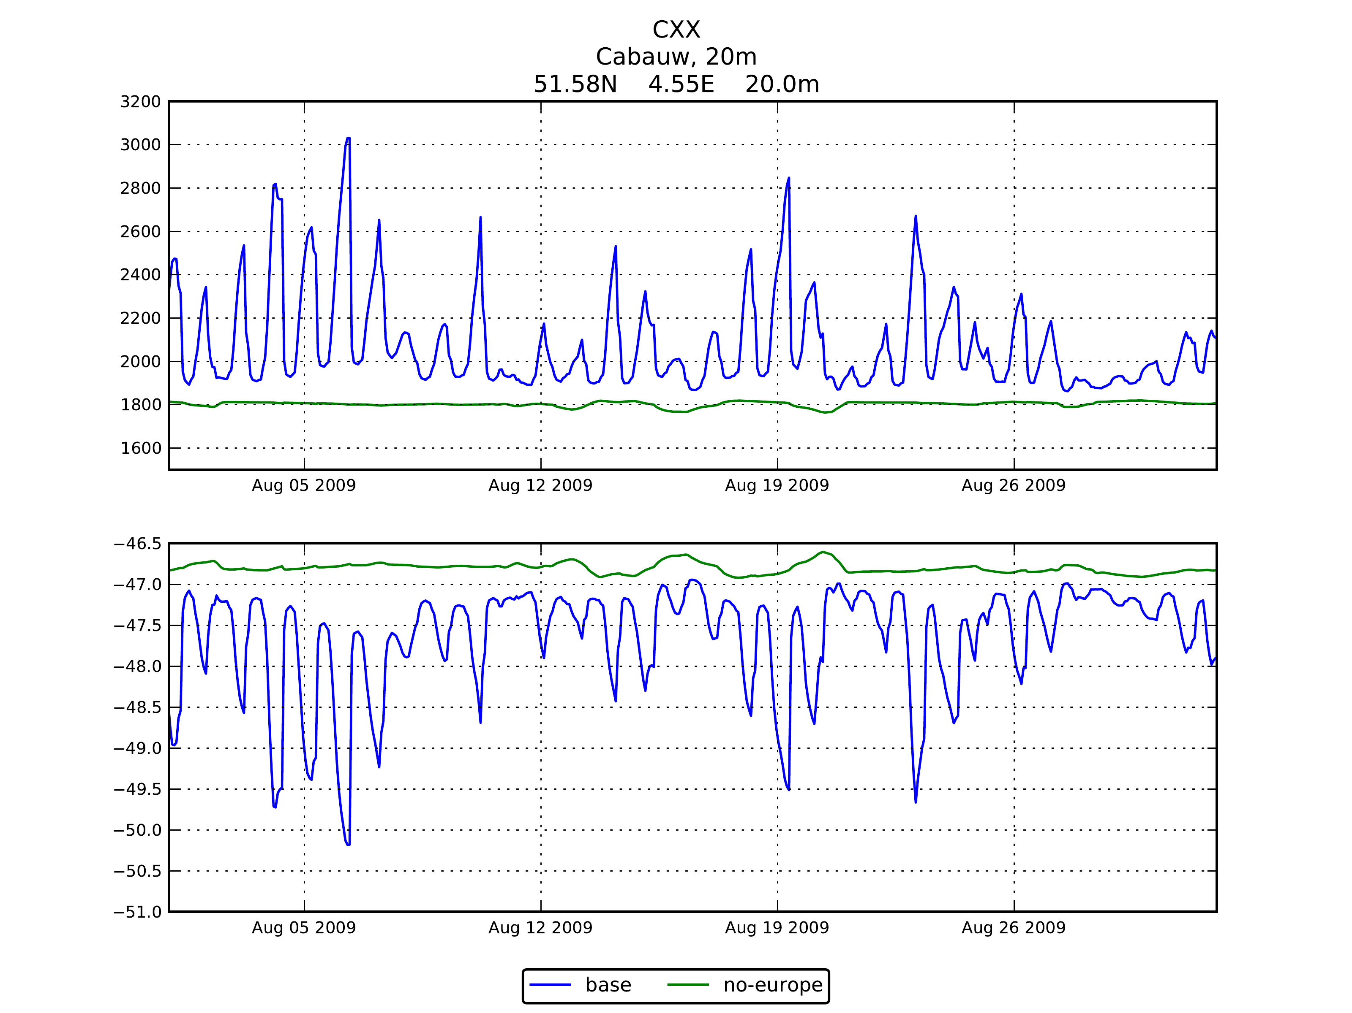
Base scenario

Slide 18
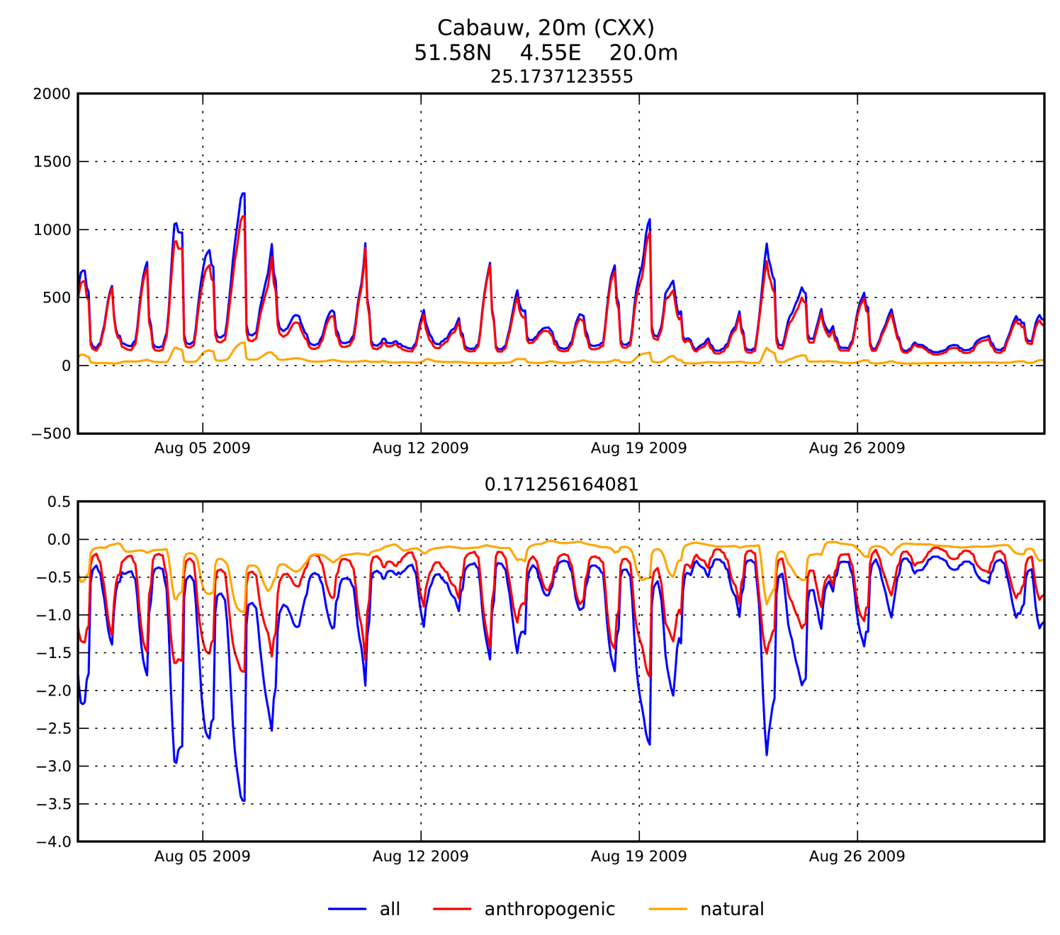
Source attribution: natural vs. anthropogenic
Contribution from natural sources (wetlands) easier to distinguish in d13C measurements

Slide 19
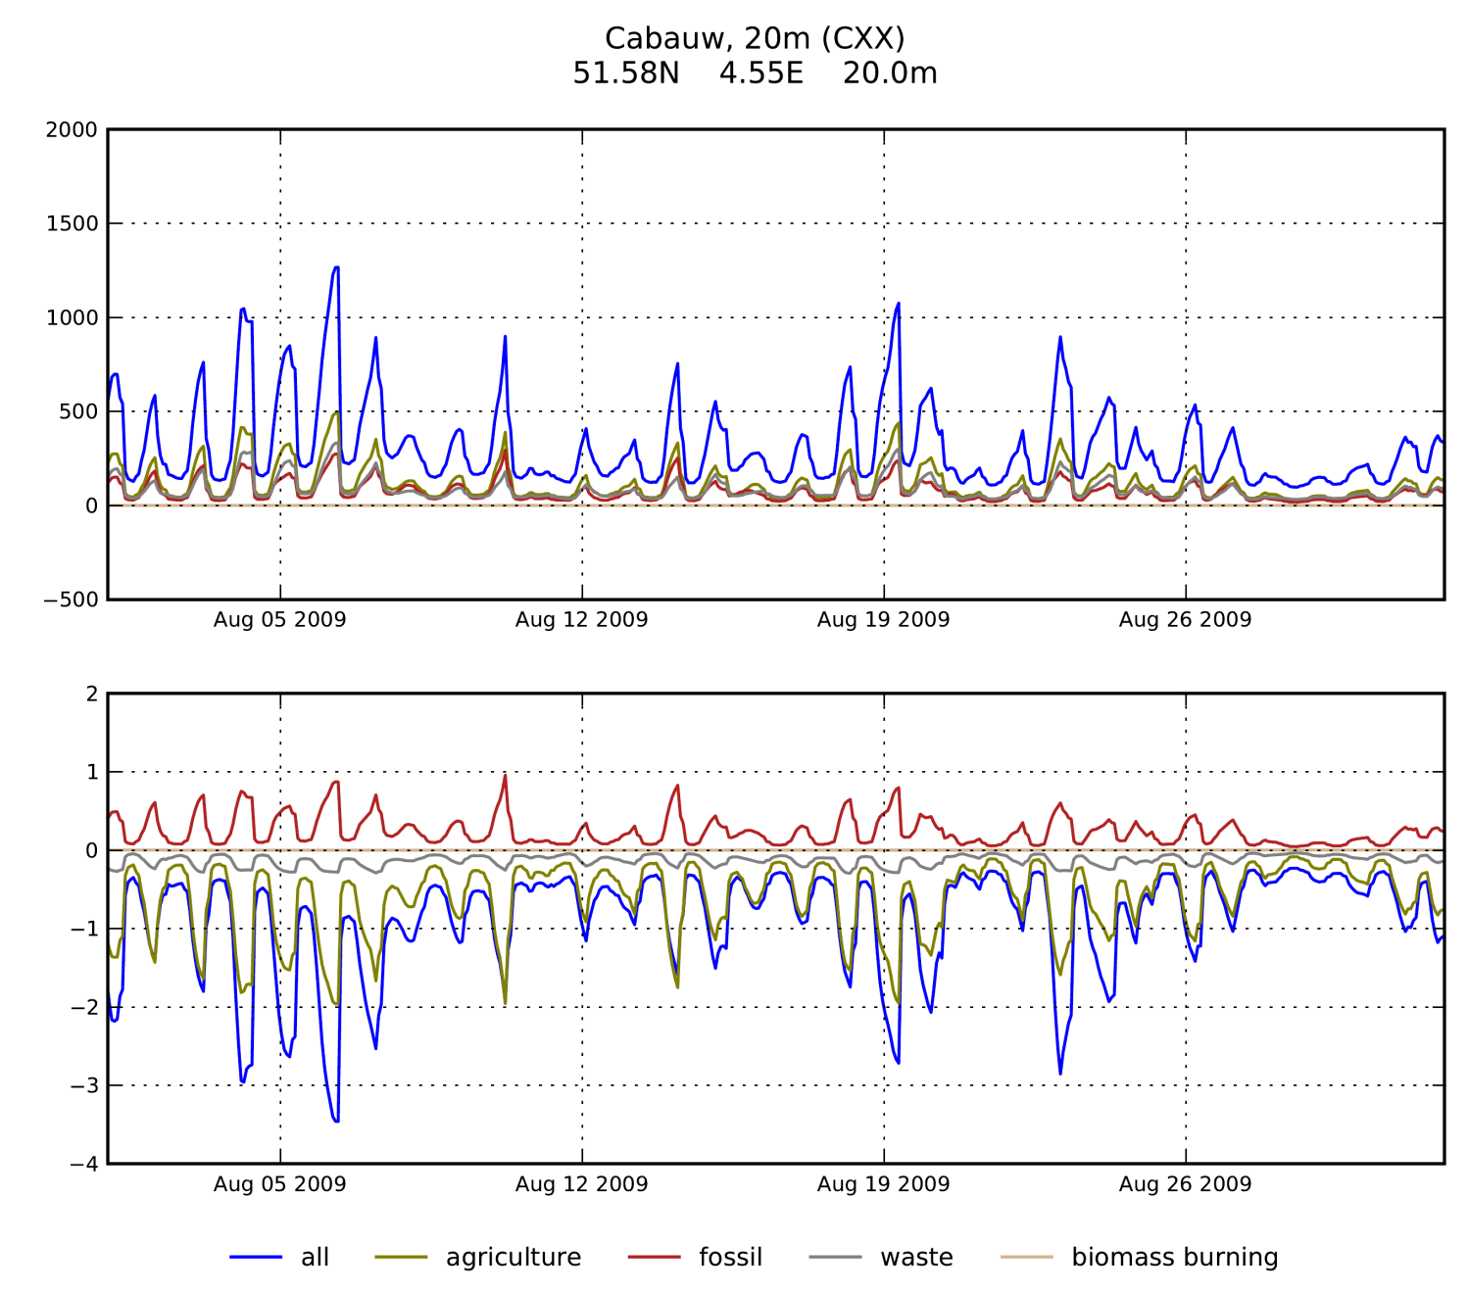
Source attribution: anthropogenic sources
Contribution from natural sources (wetlands) easier to distinguish in d13C measurements
Contributions from agriculture (enteric fermentation + manure, mostly) and fossil fuel sources can be distinguished

Slide 20
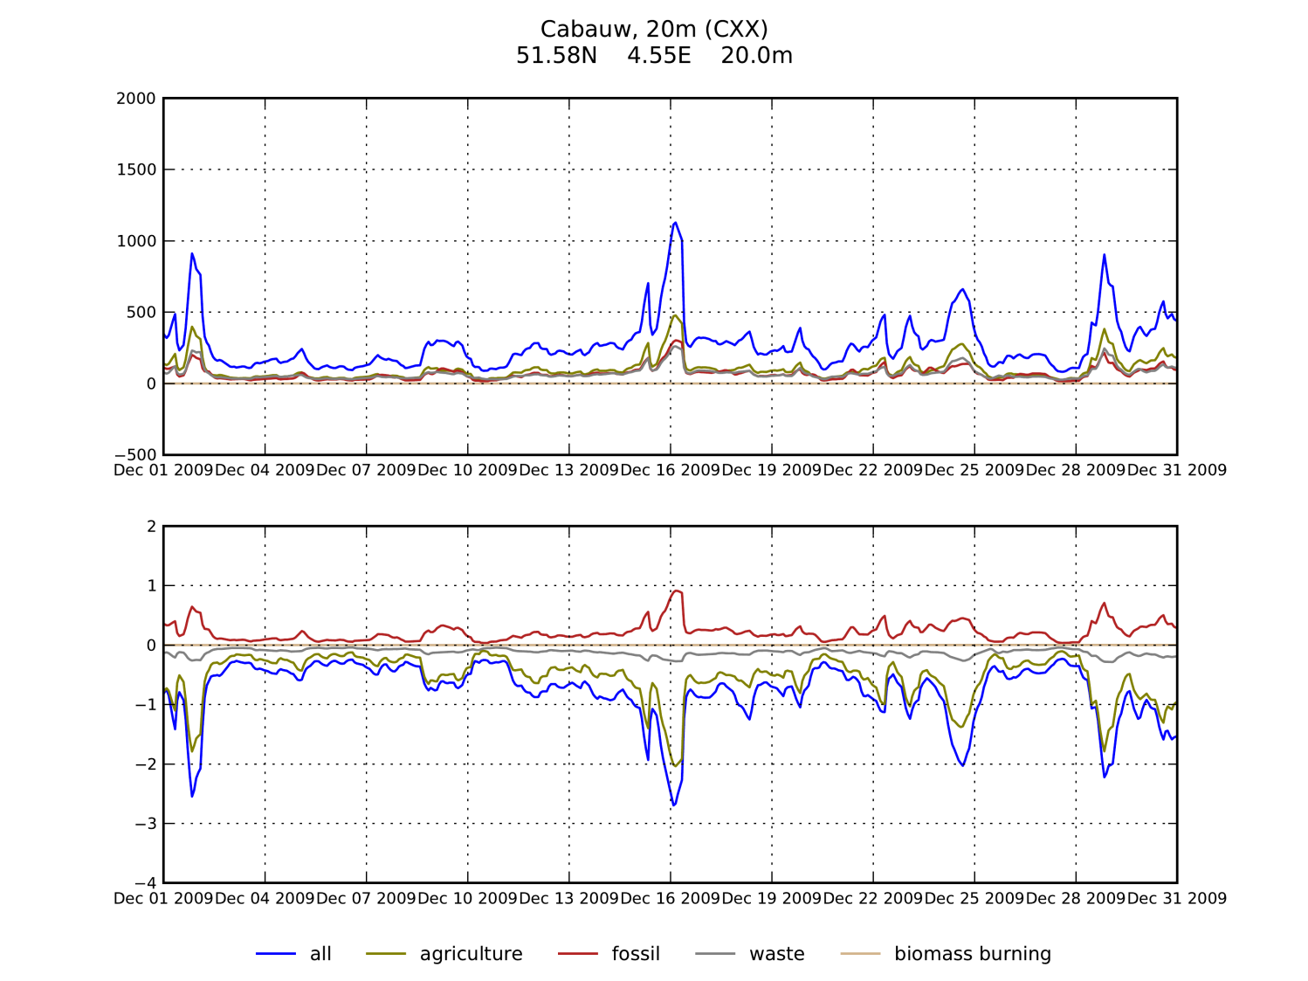
Source attribution: anthropogenic sources (winter)
Contribution from natural sources (wetlands) easier to distinguish in d13C measurements
Contributions from agriculture (enteric fermentation + manure, mostly) and fossil fuel sources can be distinguished
The emissions are very smoothed by the grid size

Slide 21
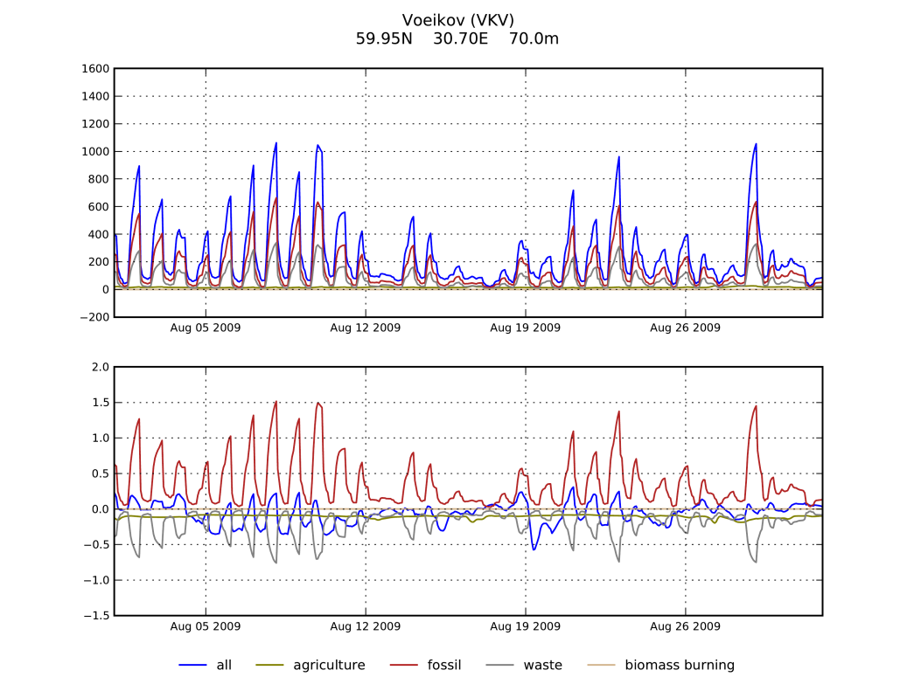
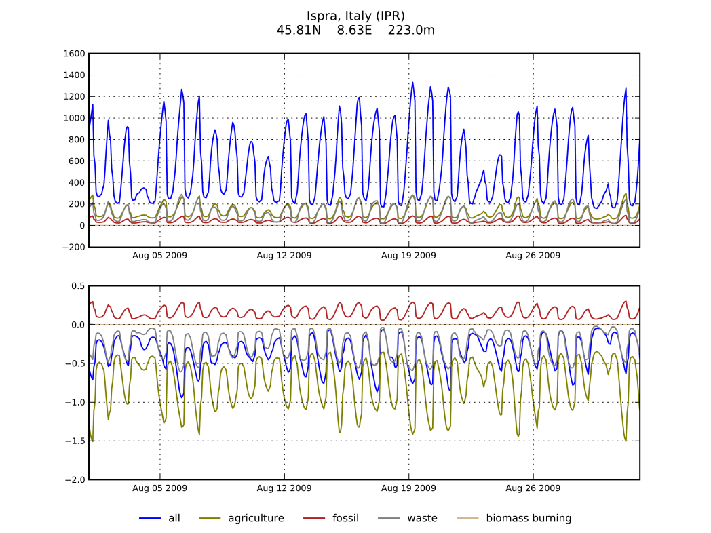
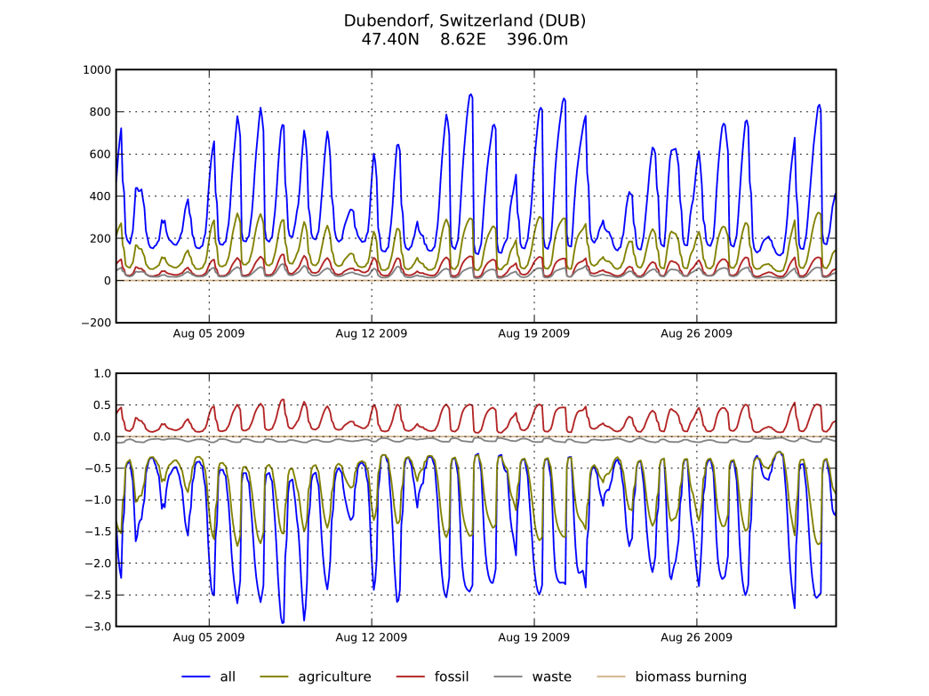
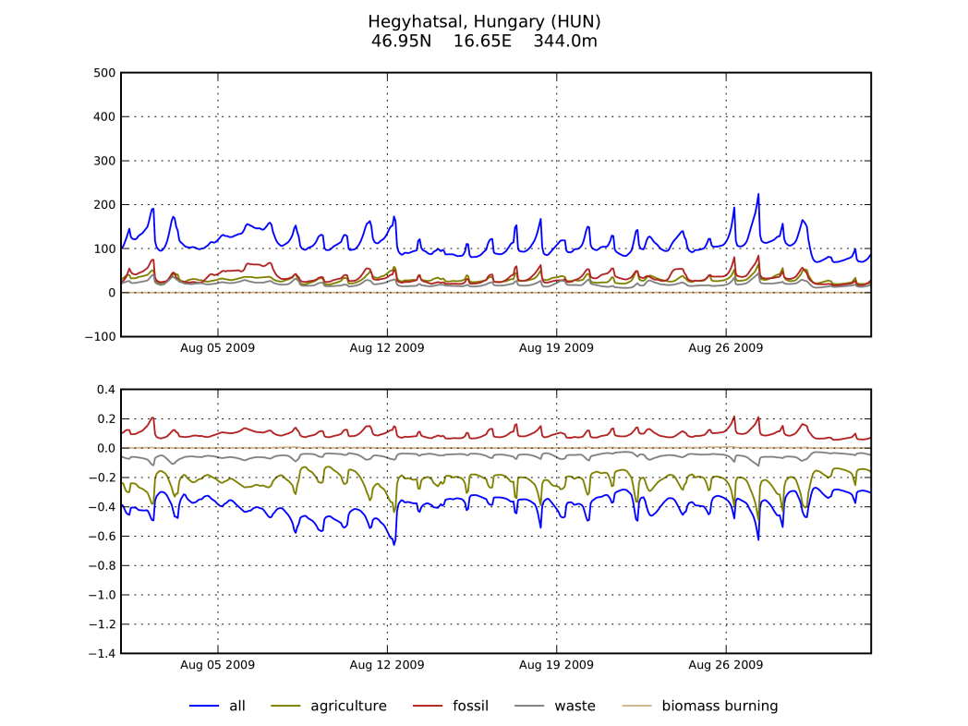
Source attribution: other locations

Slide 22
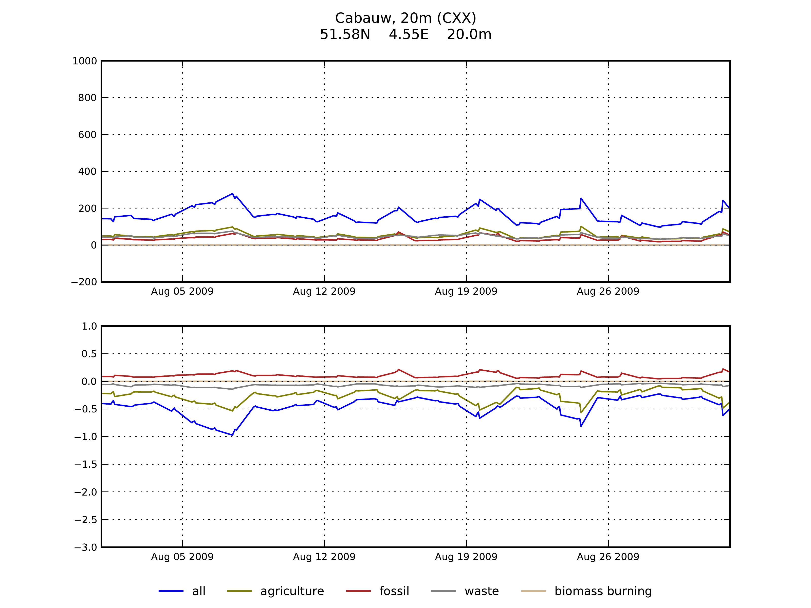
Daytime observations

Slide 23
To be done
Observed signals vs. source uncertainties
Uncertainties in source signatures expected to map strongly in the modelled mixing and isotopic ratios
TM5/LMDz comparison ➔ work in progress
Sub-monthly variability of emissions
Comparison with observations
When the observations are here
When the meteorology is there (~mid 2015)

Slide 24
Conclusions
European sources of CH4 should produce detecteable signals in CH4 and d13C-CH4 measurements
These signals can be interpreted if:
The uncertainty on source signatures is not too large,
The model resolution is fine enough (especially the resolution of night-time boundary layer)
➔ In a first time step, these observations may help better characterize methane source signatures, rather than methane sources themselves.

